Slide 1
Marketing Sub-Committee: Website
Evaluation of current Silicon Valley Monterey Bay Council website in the roles of:
New Parent, Former Scout as Parent, Awards/Recognition,
STEM Scouting, and Alumni Chair
Bill Jennings, September 2019

Slide 2
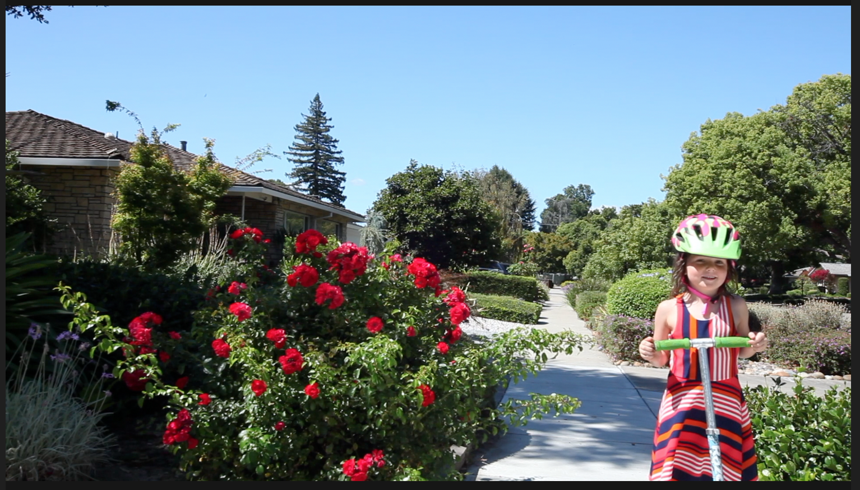
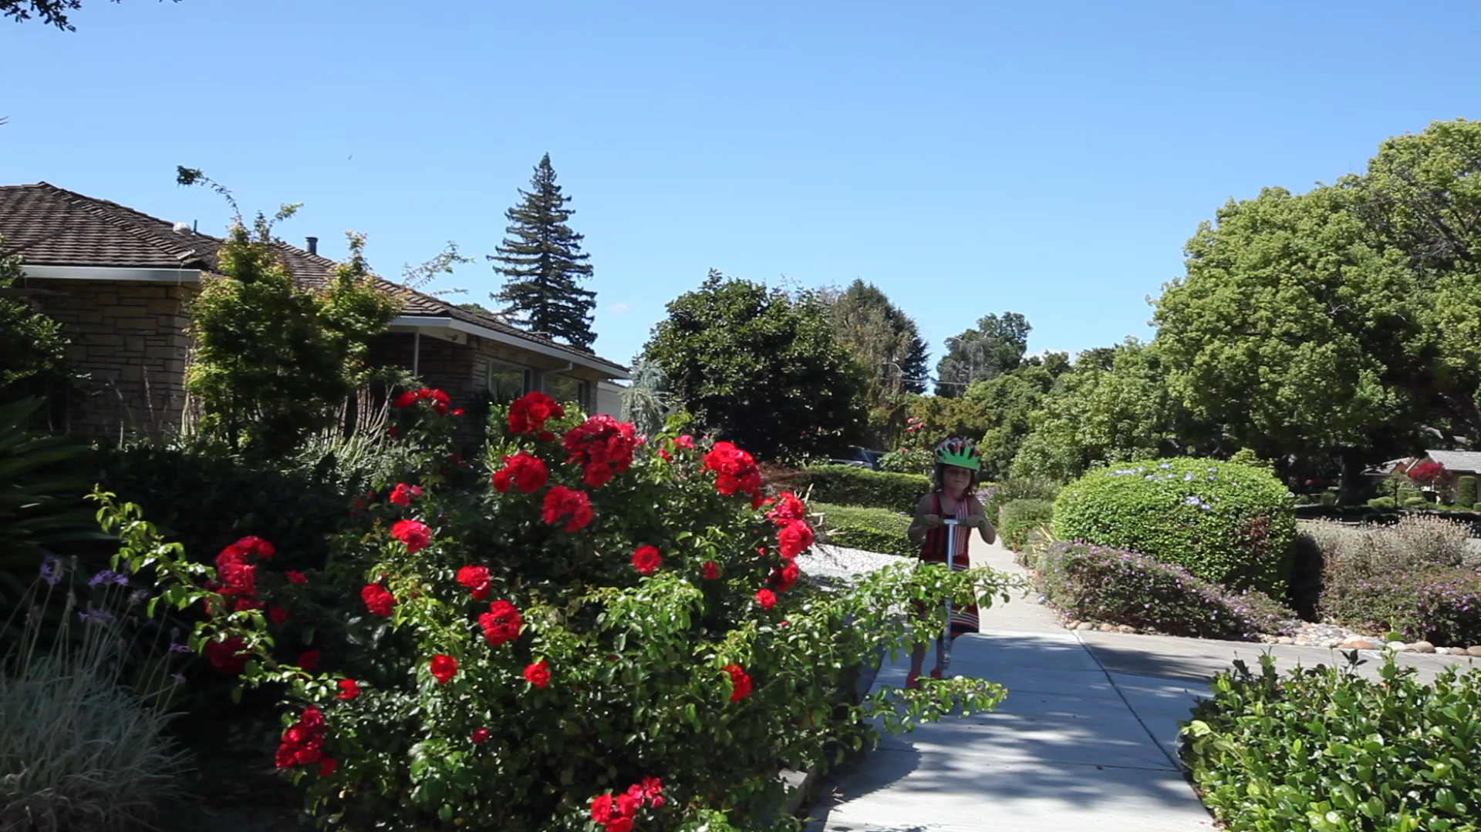

Slide 3
New Parent to Scouting
What is Scouting, why should my child participate?
There is so many different words for Scouts. Is there a simple decoder ring for the vocabulary?
How do I know what type of Scout my child would be, and how do I find the best place for them?
What time commitment is there, for my child? For me?
My kid plays in Band and Soccer: can he still be in Scouts?
Can they be with their school friends? Where do they meet? when do they meet? How much does it cost to join? And to participate?
Do I have to join at the start of the school year?
I hear girls can join Scouting. Are the meetings co-ed?
Is there a calendar I can look at to know what activities there are?
Who can help me find information about Scouting for my child?

Slide 4
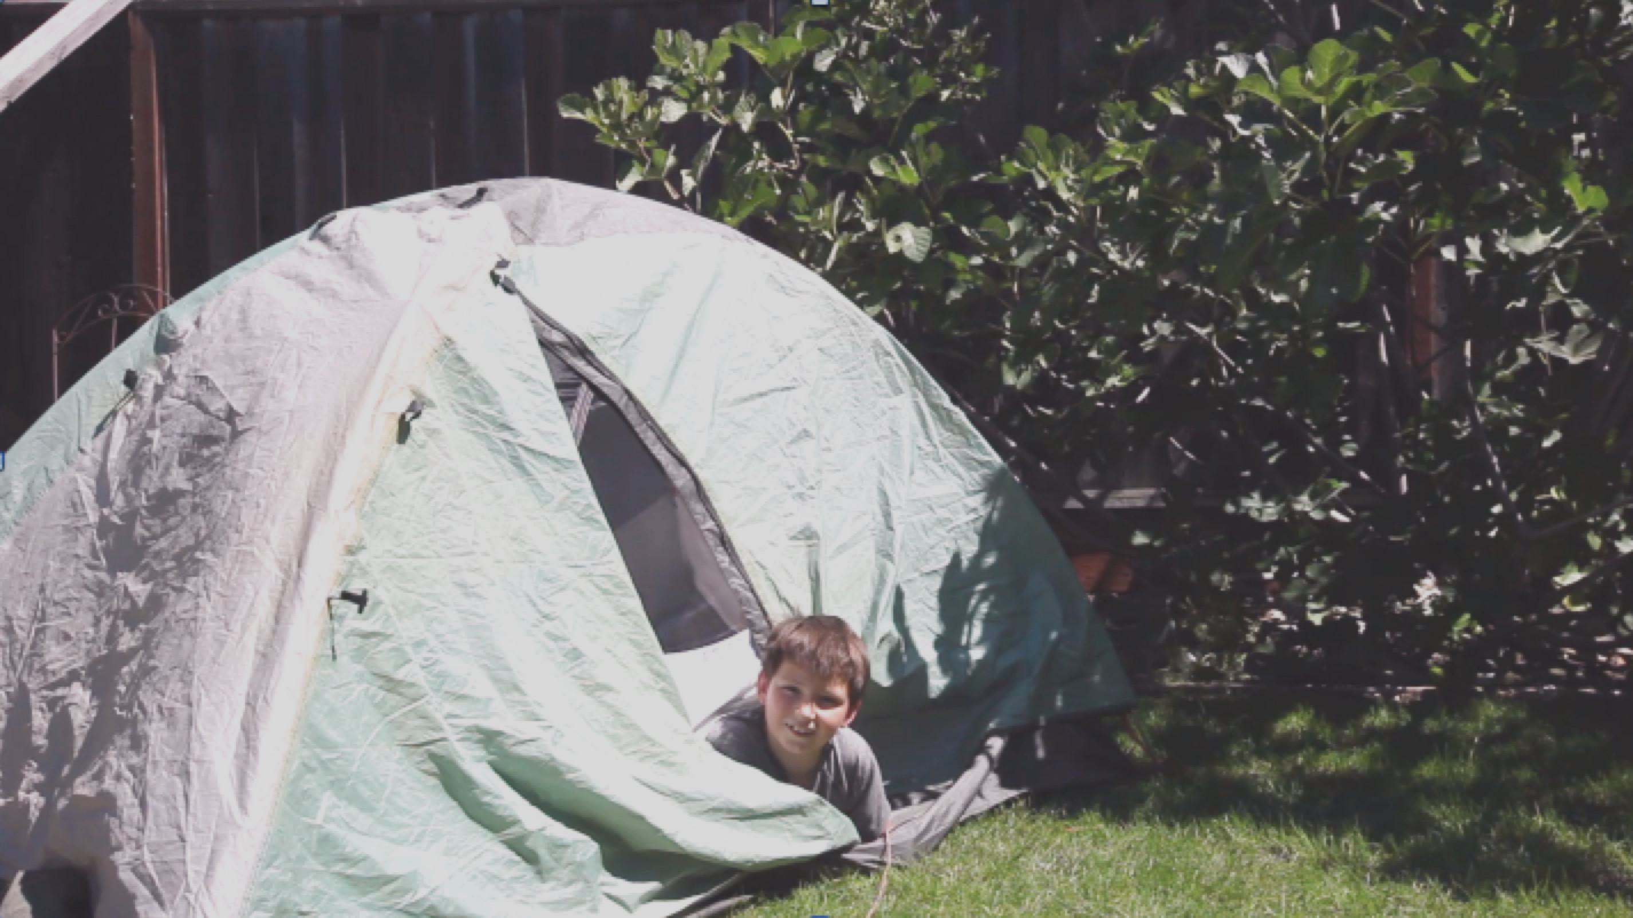
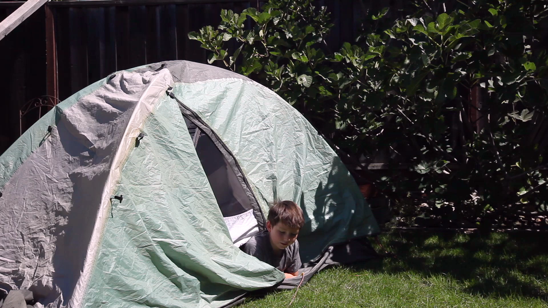

Slide 5
Former Scout as Parent
What’s changed since 30 years ago?
How do I find the best pack / troop near me for my son?
How can I be part of my son’s pack / troop? I’ve never been a Scouter before.
Where does the OA lodge / chapter meet, and when are their meetings?
How good is the Council’s Camp? How many, where are they?
What’s unique about SVMBC?
How active is the council in national events?
How come there are so many more Eagles percentage wise than when I made Eagle? Is it that much easier? Is the program watered down now with all I have read about recently?

Slide 6
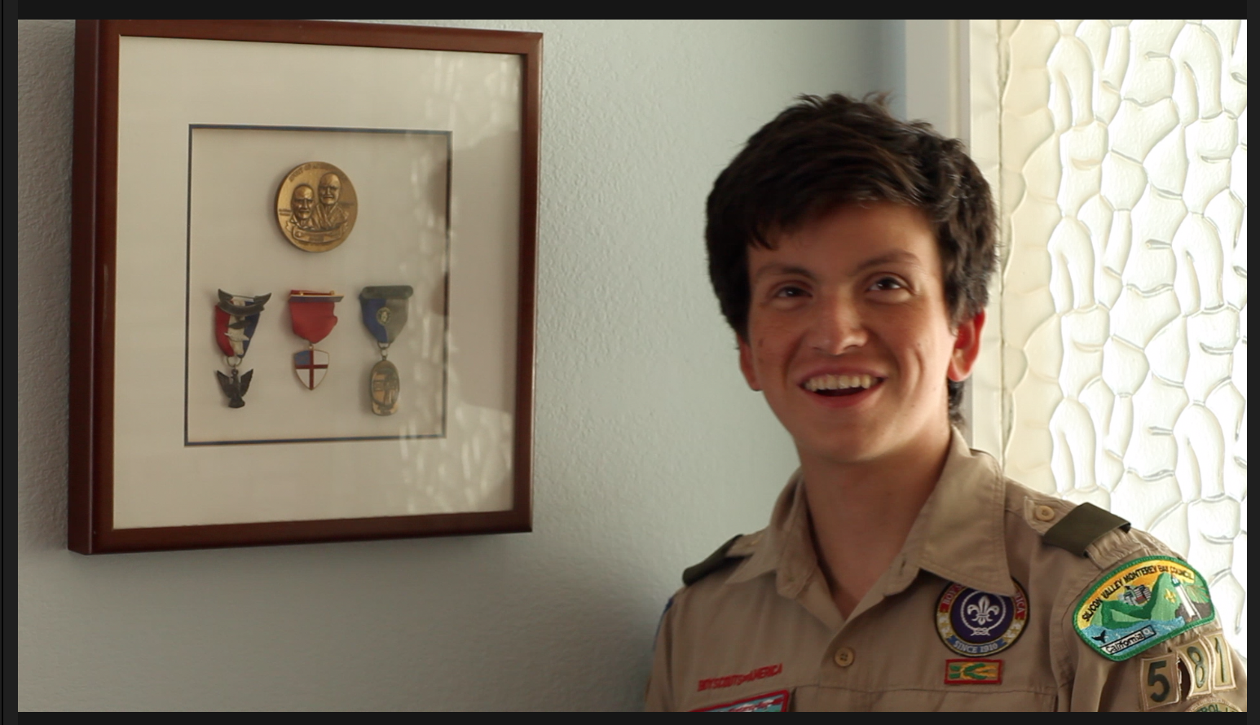
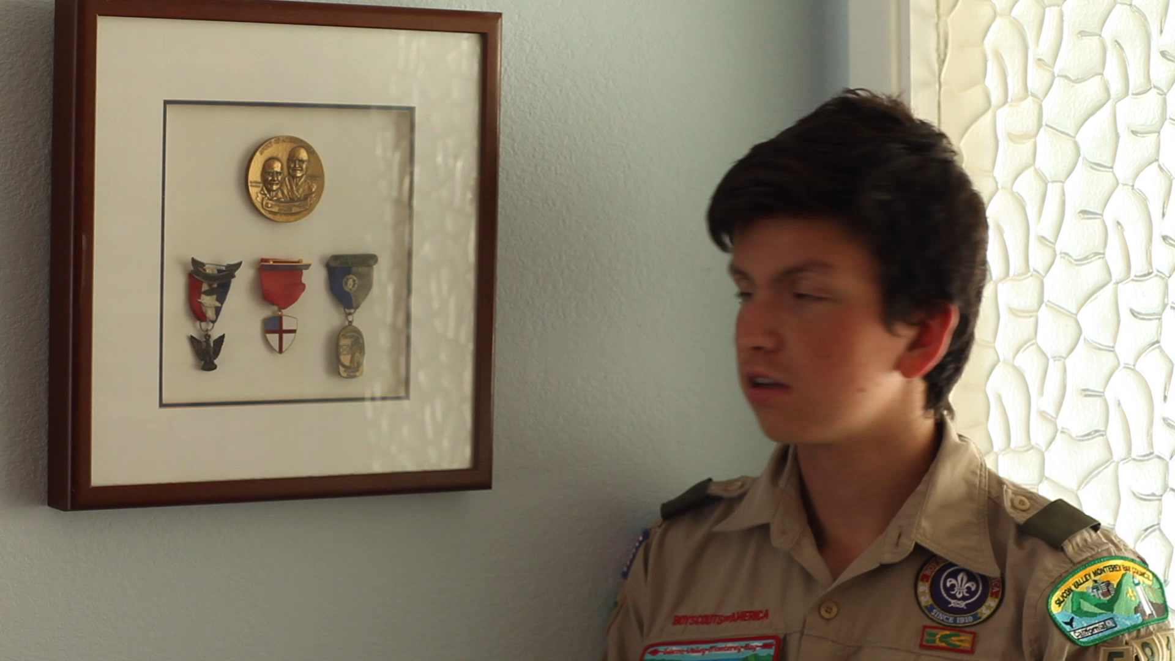

Slide 7
Awards and Recognition
What are the top youth awards? Are the requirements available to review?
What are the current adult awards available? What are these knot badges I see that make Scouters look like Generals? How are they earned, and or received?
If it’s an award that needs to be nominated, who do I send the nomination to? For Honor Award, Award of Merit? For Hornaday Award for Adults?
Are there Council specific awards (Camp Honor Society?)
Who are the former Silver Beaver and District Award of Merit recipients?
I’ve been with Scouting for 50 years now, is there an award for that?
I want to honor someone with a donation in their name, I’ve heard that is an award if the donation is large enough. What do I do?
How are the Religious Awards earned?
I’ve lost my Eagle Certificate and want a replacement?
My son made Eagle this year, how do I get his name in the Annual Report of Eagles, and get a copy for myself?

Slide 8
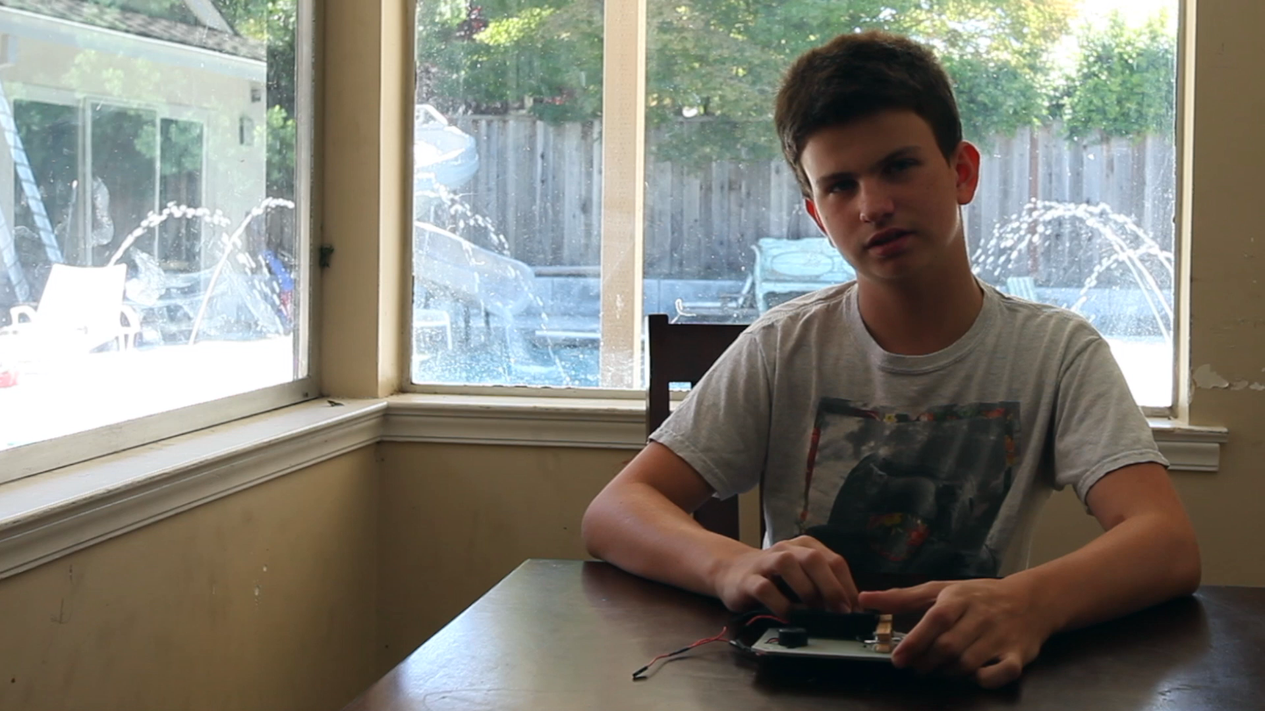
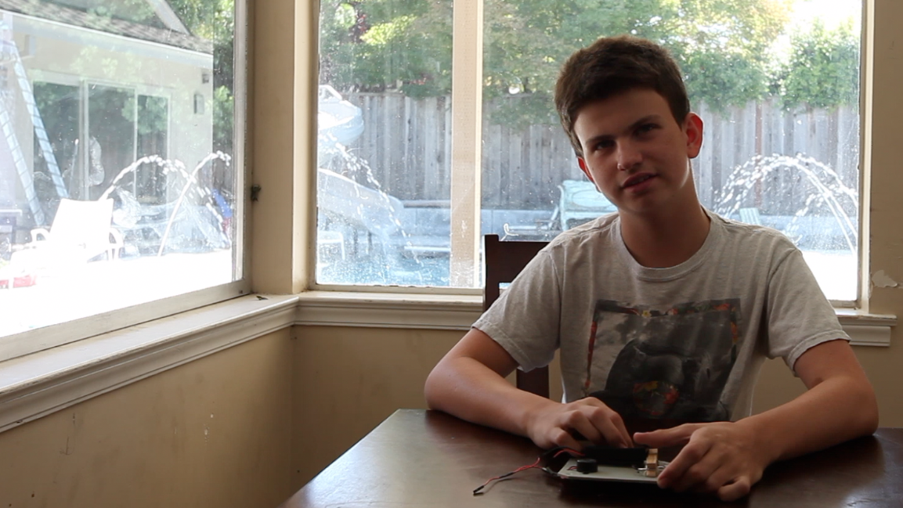

Slide 9
STEM Scouting
What is it? Why is a Scouting program? How does it integrate with other Scouting programs (Camp, OA, etc.)?
Is it a program in a box for a Scout Troop? Venturing Crew?
Is it it’s own thing?
Does it have ranks, merit badges, special camps, awards?
How many units are there and when do they meet? I would like to visit one and see it in action? Are their pictures of recent events?
This is new to me, is it a national program or only here in the council?
Is it specialized to one part of STEM, or is it a broad program?
Who in the Scout office can I speak with?
Is it co-ed, what ages can participate?

Slide 10
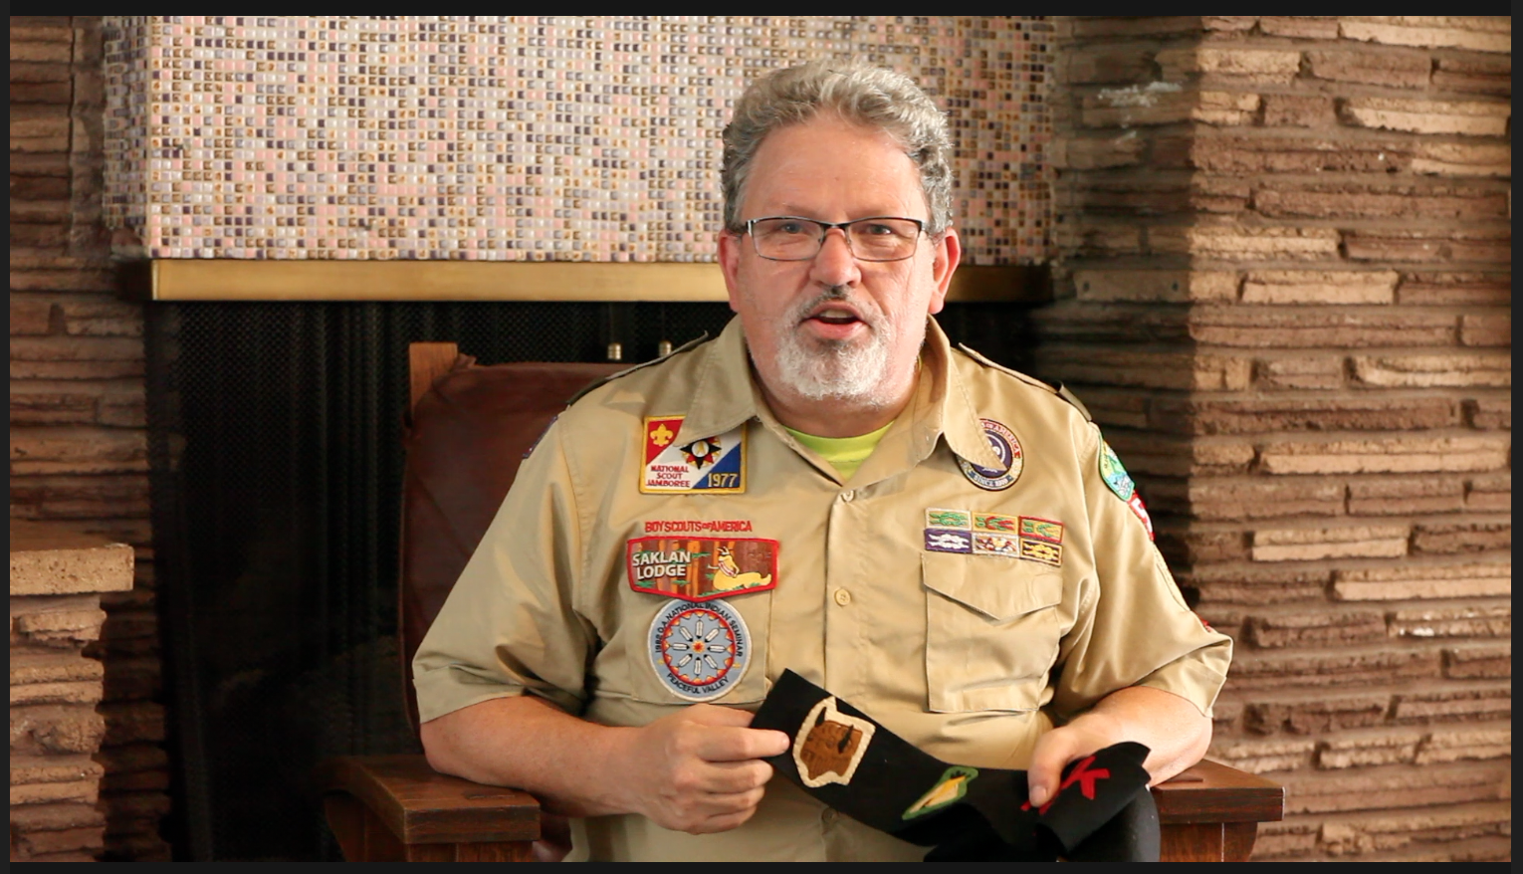
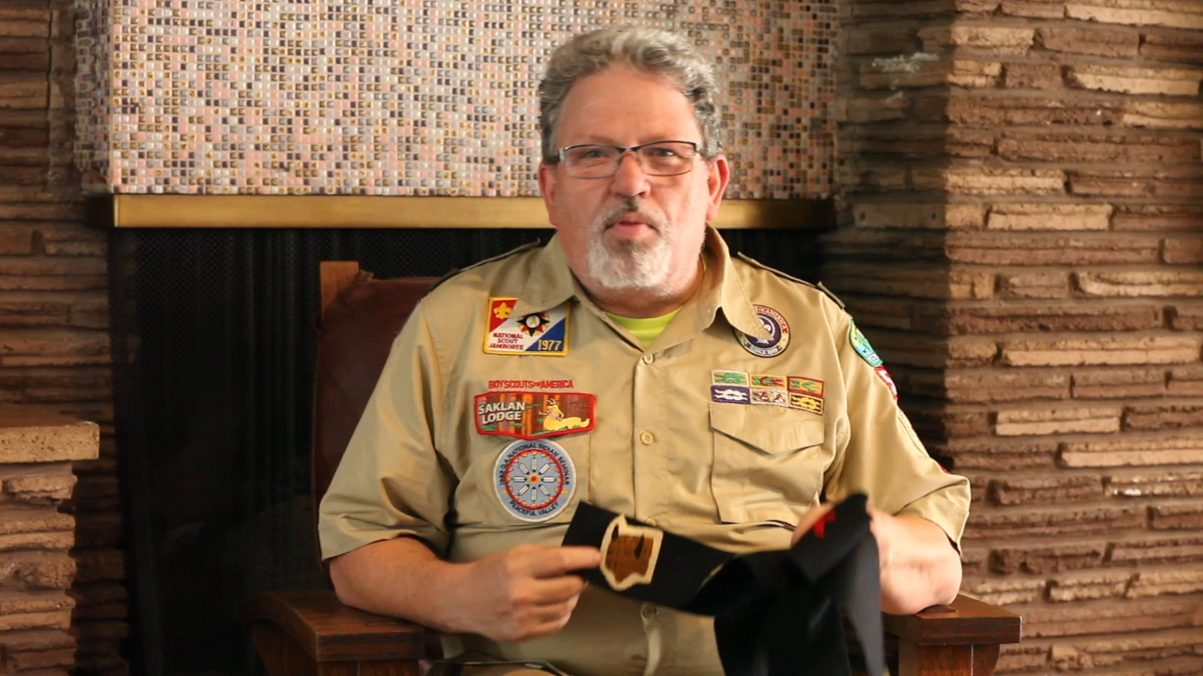

Slide 11
Alumni Chair
Who’s the council Key Three
Who is on the board?
How do the committees integrate into the annual and strategic planning cycle? How does the budget thing work?
How do I get onto the calendar for events for the Council? On the weekly Email Blast? On the Social Network Feeds?
How can I access the mailing list of all the alumni of Scouting in the area?
What active affiliate groups are there in the council? Who leads them? When do they meet? How do they communicate?
How can I keep the web content fresh for Scouting Alumni and Friends?
How can I get committee participation on the Scouting University Midway? All council events?
How does Alumni integrate with the Council Endowment? The Scouting Foundation?

Slide 12
Website Browsing Results

Slide 13
Website Browsing Results
Role | # of Questions | # of Questions fully answered | # of Questions partially answered | # of Questions without any answer
Parent, no prior Scouting experience | 15 | 3 | 2 | 10
Parent, former Scout | 11 | 0 | 2 | 9
Awards/Recognition | 15 | 5 | 5 | 5
STEM Scouting | 14 | 0 | 0 | 14
Alumni Committee | 17 | 3 | 2 | 12

Slide 14
Summary
Current Website effective for those active
in the program and have a context for finding information
New participants to Scouting would be lost quickly with the lack of context – with so many programs and so much unique vocabulary
Deep Insiders would not be able to use the website effectively to run the operations of their committees – need another vehicle for communicating to the operational leads (volunteer and professional) of committees and the like
Very little differentiation relative to other youth activities, or other Scouting Councils
Onboarding new Scouts / Scouters can’t happen with this website, need other means to do this.

