Slide 1
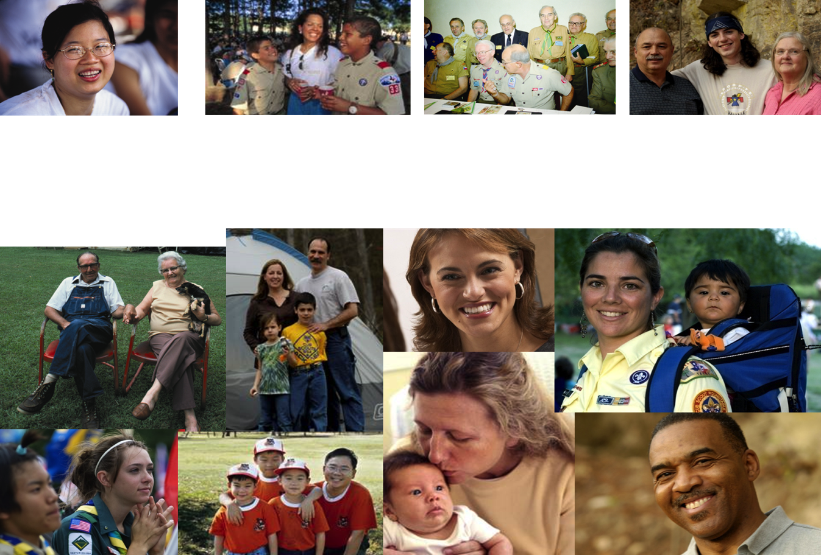
GENERATIONAL DIVERSITY

Slide 2
Objectives
Identify characteristics and gain a better understanding of alumni generations
Improve communications and engagement
Provide tips and suggestions for overcoming generational differences
Notes:
What we are going to do today is to get a deeper understanding of why people of different age groups tend to think, feel, and act as they do. You’ll learn a variety of strategies and techniques for finding “common ground” for working more effectively, collaboratively, and productively with everyone on your team.

Slide 3
What is a generation?
A generation is a group of people born around the same time and raised around the same place
People in this “birth cohort” exhibit similar characteristics, preferences, and values over their lifetimes
Generations are not a box, but give powerful clues as to how to connect and influence people of differing ages

Slide 4
Generational Exercise for Class
Everyone (including Bill, Rick and Ryan) take a few minutes, and be ready to answer these questions...
  What’s one world event that was very significant to you?
  What key technology advance occurred when you were a young adult?
  What is your preferred way to communicate to other individuals (when not in the same room/area)?
  What excites you / motivates you most when you participate in Scouting?
Poll class after a few minutes and see the (likely) contrasts in the room… Potentially generational?

Slide 5

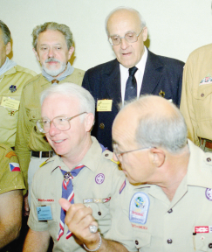
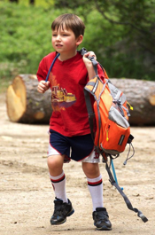
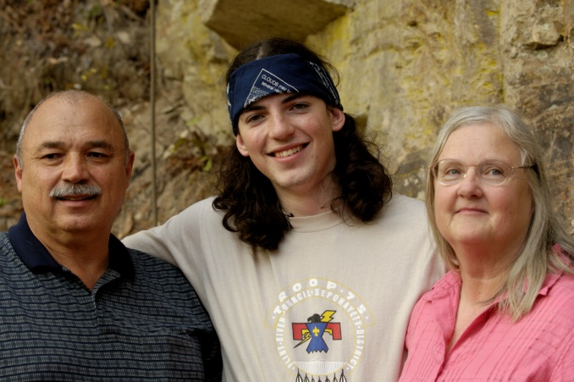
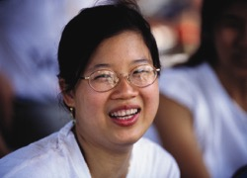
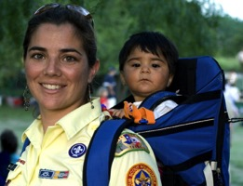
Generation Characteristics
Notes:
The events that we experience in our youth help shape our worldview. These are the defining events that shape a generation and bind us together in the way we work and live our lives.
For the Traditionalists, living as a youth through the Great Depression and the New Deal policies of FDR helped shape their attitudes about work. They learned the values of work and stability, and seek that in their lives because of these early experiences. They also helped in the war efforts as a youth and remember their fathers and other family members going to and returning from World War II. Some also took part in WWII or the Korean War.
Baby Boomers generally see the world in black and white when asked about diversity because they were youth during the civil rights movement. They were also shaped by the Feminist movement and were the first generation in which females moved into the workplace and stayed there in record numbers. Baby Boomers lived during a time of protest and civil disobedience over the Vietnam War and the assassination of major political leaders. They also witnessed space travel in their youth and saw a man walk on the moon. Space travel represents adventure and limitless possibilities. Science advances including vaccines eliminated diseases. Credit cards were introduced and increased this generation’s spending. Televisions became common in households and kids and adults watched programs like Romper Room, I Love Lucy, The Jack Benny Show, Dragnet, Gun Smoke, and The Rifleman.

Slide 6
On-the-Job Strengths
 | Trads | Boomers | Xers | Millennial
Job Strength | Stable | Service-oriented/team players | Adaptable and techno-literate | Multitaskers and techno-savvy
Outlook | Practical | Optimistic | Skeptical | Hopeful
View of Authority | Respectful | Love/hate | Unimpressed and un-intimidated | Polite
Leadership | By hierarchy | By consensus | By competence | By pulling together
Relationships | Personal sacrifice | Personal gratification | Reluctant to commit | Inclusive
Notes:
Talk about the characteristics and how some of these things can cause challenges in the workplace.

Slide 7
Generational Challenges We Face
Poor communication
Decreased productivity, quality and innovation
Misunderstood attitudes, relationships, and working environments
Less-engaged volunteers and coworkers
Lack of motivation, initiative, and teamwork
Notes:
We can create a frustrating place to work when we fail to understand each other and how to work together.

Slide 8
Bridging the Generation Gaps
“We have absolutely nothing
in common!”
“We have so much
in common!”
Notes:
Have you ever felt this way with someone from another generation?

Slide 9
Bridging the Generation Gaps
What characteristics do you need to have to engage Scouting alumni?
    Knowledge
    Skills
    Experiences
    Attitudes
    Empathy/Sympathy

Slide 10
Bridging the Generation Gaps
For you
  Appreciate differences of the alumni you engage
  Acknowledge your interdependency and remember common values
  Not one style works for all, include multiple types of communications to the alumni
  Leverage what motivates
  Embrace the diversity and thrive

