Slide 1
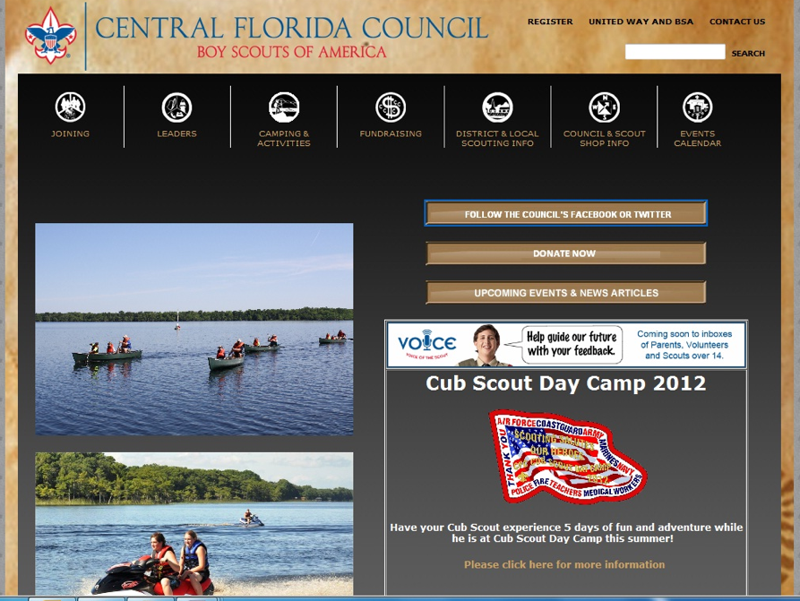

Alumni Success Stories
Reconnection Event at Camp Lo-No-Che
Organized local alumni association
Used videotape of Council Camporee as promotional tool to remind of fun of summer camp
https://www.youtube.com/watch?v=Sy1uTbrpfLc

