Slide 1
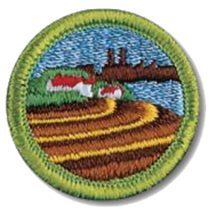

Soil and Water
Conservation
Merit Badge
Mr. Bill Jennings
ASM Troop 581/582

Slide 2
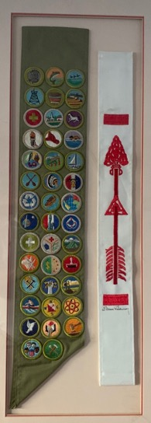
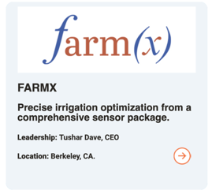
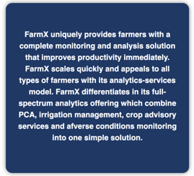
Soil and Water Merit Badge – Counselor Intro
  Mr. Bill Jennings : ASM 581 / 582
  Earned Merit Badge in 1974! as my sixth merit badge.
  Chief Technology Officer of FarmX: a recognized leader in water conservation for commercial farmers in California. Three patents in Soil Moisture Sensing.

Slide 3
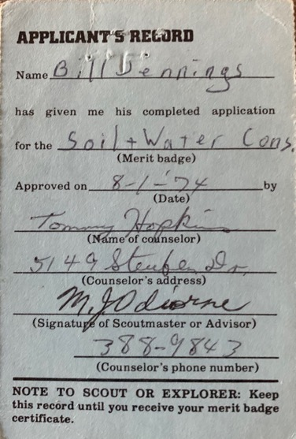
Mr. Bill Jennings’ Blue Card for this Merit Badge
Yep, prior to Scoutbook, we used Blue Cards exclusively – here is my applicant’s record from 1974 that was signed by my Scoutmaster Milo J. Odiorne!
Back then, you didn’t have to dial the area code when you called someone!!!

Slide 4
Our plan for learning this merit badge
I can’t require worksheets for the merit badge, but I do need to insure all Scouts know the material individually. I will have an interactive lecture for most of the requirements – I suggest that you take notes. I will follow-up with each of the Scouts to verify you know the material we discussed before signing off the requirements.
One way to structure your notes is to use a worksheet found on this URL:
  https://scoutingevent.com/attachment/badges/Soil_and_Water_Conservation.pdf

Slide 5
Soil and Water Conservation Merit Badge Requirements: version 2019
URL for requirements: We will be using requirements from 2019, as none of the students began this merit badge prior to 2020:
https://filestore.scouting.org/filestore/Merit_Badge_ReqandRes/Soil_and_WaterConservation.pdf

Slide 6
Requirements that need to be done outside of lecture/video conference
Requirements 2d, 3c, 5a, and 6d will require you to draw or take pictures of certain things to fulfill the requirements. This you have to do on your own somehow (I can help give ideas of what to do).
Requirements 4b, 4c: show two watersheds on topo map. Find the watersheds, and show them on a topo map.
Requirement 5b: Show by demonstration at least two of the following actions of water in relation to soil: percolation, capillary action, precipitation, evaporation, and transpiration. For another Scout, I asked the Scout to boil water (evaporation), and then also to pour water in the ground (percolation): and have a family member video tape it or tell me it was demonstrated to them.
Requirement 7 can’t be done online. Needs field work or study of a soil report. Please review this requirement and let me know your thoughts on fulfilling this requirement.

Slide 7
Merit Badge Pamphlet is a handy tool
Having a merit badge pamphlet is not required.
A pamphlet can be (optionally) purchased at the Scout Shop.
Some versions have been posted online, probably breaking copyright rules.
If you happen to find one, it may help you study this badge after our discussions.
https://www.troop109nj.com/app/download/5843938/Soil+and+Water+Conservation+Merit+Badge+Pamphlet+35952.pdf

Slide 8
Requirement 1
Do the following:
  Tell what soil is. Tell how it’s formed.
  Describe three kinds of soil. Tell how they are different.
  Name the three main plant nutrients in fertile soil. Tell how they can be put back when used up.

Slide 9
Requirement 1a
Tell what soil is. Tell how it is formed.
Soil is a mixture of organic matter, minerals, gases, liquids, and organisms that together support life.
The crumbling of rock is a process that leads to soil formation. Finely ground or splintered rock will not become soil until it begins to surge with life. Living and once-living plants and animals—organic matter—help give soil a physical structure that admits moisture and air and helps the soil retain them. To be useful, soil must keep its structure.
As bits of crumbled material and moisture collect on a rock, simple plants called lichens begin to grow. After some time, water, decaying lichens, and more bits of mineral matter collect in the rock crevices. Soon, microscopic forms of plant and animal life begin to make the crevices their home. Mosses begin to grow on the rock, and later the seeds of larger plants germinate in this loose earthy material; these weeds, grasses, and other plants grow, die, and decay, thereby supplying organic matter.

Slide 10
Requirement 1b
Describe three kinds of soil. Tell how they are different.
Another characteristic of a soil is the size of the solid particles it contains. In describing soils, the different-sized particles are called sand, silt, and clay.
Fine soil feels smooth like flour. Moisten some and work it into a thin ribbon between your thumb and forefinger. If the ribbon breaks off near your fingers each time, chances are the soil is largely silt—particles ranging from 0.002 to 0.05 millimeters in diameter. You cannot see the individual particles without using a strong magnifying glass.
Does the soil between your fingers feel like fine powder when dry? After you moisten it, does it make at least an inch long ribbon before breaking when you work it between your thumb and finger? If so, you have mostly clay—particles smaller than silt and less than 0.002 millimeters in diameter. When soils experts refer to soil texture, they are talking about the size of the soil particles. When a soil is identified as a loam (this term refers only to the size of particles it contains), it means that the soil contains a relatively even mixture of sand and silt and a somewhat smaller proportion of clay. This generally is a desirable quality in soil.

Slide 11
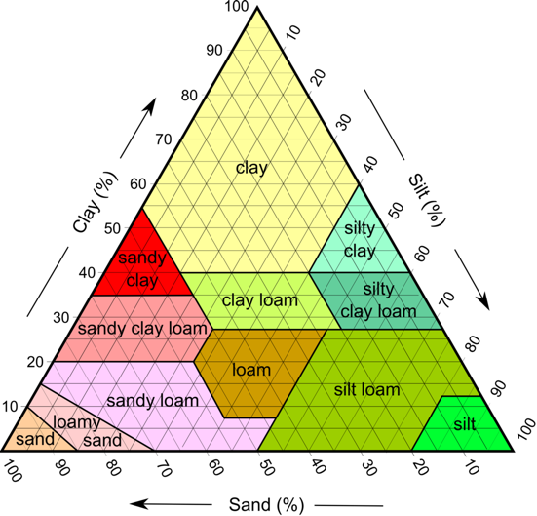
Requirement 1b
Describe three kinds of soil. Tell how they are different.
Clay holds water for a long time
Water runs through sand quickly
Plants do well in loam – balance of
water retention and not too much
water than can cause disease.

Slide 12
Requirement 1c
Name the three main plant nutrients in fertile soil. Tell how they can be put back when used up.
Fertile soil can supply the complete nutritional needs of a growing plant. The three principal plant nutrients are nitrogen, phosphorus, and potassium. Plants usually need only exceedingly small or trace amounts of sulfur, calcium, iron, manganese, magnesium, molybdenum, boron, copper, zinc, and several dozen other chemical elements, but they must have them.
Chemical soil tests help determine how much of which nutrients are needed for the best growth of different kinds of plants. As far back as around 200 b.c., the Romans already knew how to maintain soil fertility: crop rotation (planting different crops on a piece of land in a planned sequence), adding lime to soils to reduce acidity, adding manure, growing legumes (adds nitrogen to soil: peas, beans), and (modern) adding fertilizer.

Slide 13
Requirement 2
Do the following:
  Define soil erosion.
  Tell why soil erosion is important. Tell how it affects you.
  Name three kinds of soil erosion. Describe each.
  Take pictures of draw two kinds of soil erosion.

Slide 14
Requirement 2a
Define soil erosion
Soil erosion is the displacement of the upper layer of soil; it is a form of soil degradation. This natural process is caused by the dynamic activity of erosive agents, that is, water, ice (glaciers), snow, air (wind), plants, animals, and humans. In accordance with these agents, erosion is sometimes divided into water erosion, glacial erosion, snow erosion, wind (aeolean) erosion, zoogenic erosion and anthropogenic erosion. Soil erosion may be a slow process that continues relatively unnoticed, or it may occur at an alarming rate causing a serious loss of topsoil.

Slide 15
Requirement 2b
Tell why soil erosion is important. Tell how it affects you.
Soil erosion is important because it causes soil loss in some areas and soil deposition in other places.
When soil is eroded by wind, ice, gravity or water, soil is lost from where it is formed. This original place of soil is important. Why? Because conditions exist there to form soil. Upper soil layer is fertile. Due to soil erosion, soil (upper soil) is lost. Soil formation is a very slow process.
Soil erosion causes siltation in rivers, dams, etc. In some areas, huge river deltas are formed (such as River Nile delta) because of soil erosion. Such places are good for agriculture but not good for urbanization. However, some people do not care about it, they just want to construct buildings on alluvium type soils. This is a problem since such soils are not as strong as bedrock.
Soil loss due to erosion causes agricultural income loss since agricultural areas that are subject to soil erosion becomes less fertile. Loss of fertile agricultural areas impacts all of us. Also, if erosion happens near roads or buildings, it may cause those structures or roads to fail over time (collapse into the reduced soil).

Slide 16
Requirement 2c
Name three kinds of soil erosion. Describe each.
This natural process is caused by the dynamic activity of erosive agents, that is, water, ice (glaciers), snow, air (wind), plants, animals, and humans.
Soil erosion by water (aka 'water erosion') is the result of rain detaching and transporting vulnerable soil, either directly by means of rainsplash or indirectly by rill and gully erosion.
Wind erosion is a natural process that moves soil from one location to another by wind power. Wind erosion can be caused by a light wind that rolls soil particles along the surface through to a strong wind that lifts a large volume of soil particles into the air to create dust storms.
Glacial Erosion. Glaciers erode the underlying rock by abrasion and plucking. Glacial meltwater seeps into cracks of the underlying rock, the water freezes and pushes pieces of rock outward. The rock is then plucked out and carried away by the flowing ice of the moving glacier.

Slide 17
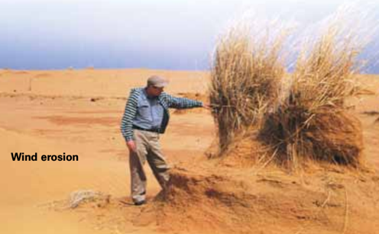
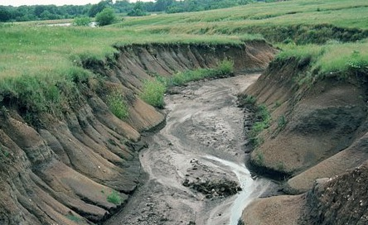
Requirement 2d
Take pictures of or draw two kinds of soil erosion.
Water erosion

Slide 18
Requirement 3
Do the following:
  Tell what is meant by “conservation practices”
  Describe the effect of three kinds of erosion-control practices.
  Take pictures of or draw three kinds of erosion-control practices.

Slide 19
Requirement 3a
Tell what is meant by “conservation practices.”
According to the Department of Agriculture, Trade and Consumer Protection, conservation practice means a facility or practice that is designed to prevent or reduce soil erosion, prevent or reduce non-point source water pollution, or achieve or maintain compliance with soil and water conservation standards.

Slide 20
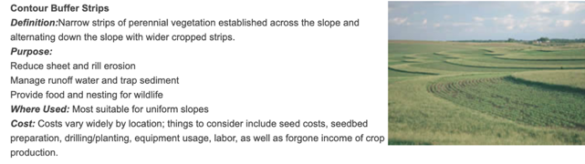
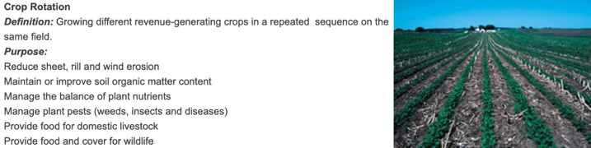
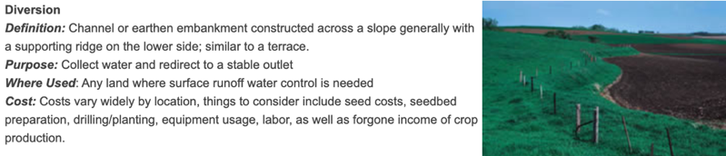
Requirement 3b, 3c
Describe the effects of three kinds of erosion-control practices. Photos.

Slide 21
Requirement 4
Do the following:
  Explain what a watershed is.
  Outline the smallest watershed you can find on a contour map.
  Outline, as far as the map will allow, the next largest watershed that also has the smaller one in it.
  Explain what a river basin is. Tell why all people living in a river basin should be concerned about land and water use in the basin.

Slide 22
Requirement 4a
Explain what a watershed is.
A watershed is an area or ridge of land that separates waters flowing to different rivers, basins, or seas.

Slide 23
Requirement 4b, 4c
Outline the smallest watershed you can find on a contour map. Outline, as far as the map will allow, the next largest watershed that also has the smaller one in it.
HOMEWORK FOR THE SCOUTS

Slide 24
Requirement 4d
Explain what a river basin is. Tell why all people living in a river basin should be concerned about land and water use in the basin.
A river basin is the area of land from which all the water flows into a particular river.
Most rivers cross several political boundaries and many types of terrain as they flow through different states on the way to the ocean. The way that land and water are used and managed in the small watersheds in the upper part of the river basin affects the quality and quantity of water people in cities downstream will have. So in dealing with the complex problems of natural resource use and population growth, attention must be given to the needs of all the people in the river basin because the river links them together.

Slide 25
Requirement 5
Do the following:
  Make a drawing to show the hydrologic cycle
  Demonstrate at least two of the following actions of water in relation to soil: percolation, capillary action, precipitation, evaporation, transpiration.
  Explain how the removal of vegetation will affect the way water runs off a watershed.
  Tell how uses of forest, range, and farmland affect usable water supply.
  Explain how industrial use affects water supply.

Slide 26
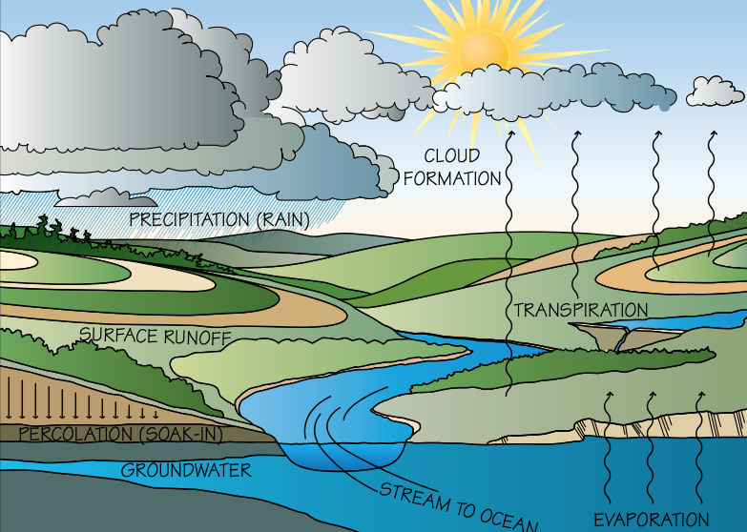
Requirement 5a
Make a drawing to show the hydrologic cycle

Slide 27
Requirement 5b
Demonstrate at least two of the following actions of water in relation to soil: percolation, capillary action, precipitation, evaporation, transpiration.
For other Scouts, I asked them to boil water (evaporation), and then also to pour water in the ground (percolation): and have a family member video record it or tell me it was demonstrated to them (have parent drop me a note saying they saw it).

Slide 28
Requirement 5c
Explain how the removal of vegetation will affect the way water runs off a watershed.
Why hasn’t all the soil been splashed, washed, and blown away by this time? You can discover the answer to this question. Have you ever seen dust blowing from a lawn that has a thick grass cover? Have you ever seen mud splash up after a rain from soil covered with grass? The grass broke the force of the falling water, and its roots held the soil tightly in place. In the same way, plants break the force of falling raindrops. Their roots help water enter the soil by keeping it porous. They hold the soil particles together so that moving water cannot break the particles apart and carry them away. Plants also slow down running water, thereby allowing some time for it to soak in. Plants growing closely together protect the soil from strong winds. The tops of the plants slow down the wind, and the roots help hold the soil in place.

Slide 29
Requirement 5d
Tell how uses of forest, range, and farmland affect usable water supply.
Agricultural water is water that is used to grow fresh produce and sustain livestock. The use of agricultural water makes it possible to grow fruits and vegetables and raise livestock, which is a main part of our diet. Agricultural water is used for irrigation, pesticide and fertilizer applications, crop cooling (for example, light irrigation), and frost control. According to the United States Geological Survey (USGS), water used for irrigation accounts for nearly 65 percent of the world’s freshwater withdrawals excluding thermoelectric power. There are 330 million acres of land used for agricultural purposes in the United States that produce an abundance of food and other products.
When agricultural water is used effectively and safely, production and crop yield are positively affected. A decrease in applied water can cause production and yield to decrease. Management strategies are the most important way to improve agricultural water use and maintain optimal production and yield. The key is to implement management strategies that improve water use efficiency without decreasing yield. Some examples include improved irrigation scheduling and crop specific irrigation management. These strategies allow for the conservation of water and energy, and decrease grower’s costs.

Slide 30
Requirement 5e
Explain how industrial use affects water supply.
Manufacturing and other industries use water during the production process for either creating their products or cooling equipment used in creating their products. According to the United States Geological Survey (USGS), industrial water is used for fabricating, processing, washing, diluting, cooling, or transporting a product. Water is also used by smelting facilities, petroleum refineries, and industries producing chemical products, food, and paper products. Large amounts of water are used mostly to produce food, paper, and chemicals.
This use of large amounts of fresh water is taken from other uses: residential consumption, and water for agriculture are impacted when there are large industrial consumers of water.

Slide 31
Requirement 6
Do the following:
  Tell what is meant by “water pollution.”
  Describe common sources of water pollution and explain the effects of each.
  Tell what is meant by “primary water treatment,” “secondary waste treatment,” and “biochemical oxygen demand.”
  Make a drawing showing the principles of complete waste treatment.

Slide 32
Requirement 6a
Tell what is meant by “water pollution.”
Water pollution occurs when harmful substances—often chemicals or microorganisms—contaminate a stream, river, lake, ocean, aquifer, or other body of water, degrading water quality and rendering it toxic to humans or the environment.

Slide 33
Requirement 6b
Describe common sources of water pollution and explain the effects of each.
Agricultural, Sewage and Wastewater, Oil Pollution, and Radioactive Waste
On human health: To put it bluntly: Water pollution kills. In fact, it caused 1.8 million deaths in 2015, according to a study published in The Lancet. Contaminated water can also make you ill. Every year, unsafe water sickens about 1 billion people. And low-income communities are disproportionately at risk because their homes are often closest to the most polluting industries.
On the environment: In order to thrive, healthy ecosystems rely on a complex web of animals, plants, bacteria, and fungi—all of which interact, directly or indirectly, with each other. Harm to any of these organisms can create a chain effect, imperiling entire aquatic environments.

Slide 34
Requirement 6c
Tell what is meant by “primary water treatment,” “secondary waste treatment,” and “biochemical oxygen demand.”
Primary treatment. Primary treatment removes material that will either float or readily settle out by gravity. It includes the physical processes of screening, comminution, grit removal, and sedimentation.
Secondary treatment is a treatment process for wastewater (or sewage) to achieve a certain degree of effluent quality by using a sewage treatment plant with physical phase separation to remove settleable solids and a biological process to remove dissolved and suspended organic compounds.
Biological Oxygen Demand (BOD) and Water. Biochemical oxygen demand (BOD) represents the amount of oxygen consumed by bacteria and other microorganisms while they decompose organic matter under aerobic (oxygen is present) conditions at a specified temperature.

Slide 35
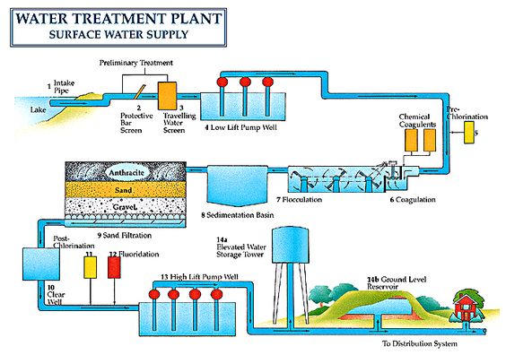
Requirement 6d
Make a drawing showing the principles of complete waste treatment.

Slide 36
Requirement 7
HOMEWORK
Requirement 7 can’t be done online with lecture.
Needs field work or study of a soil report. Please review this requirement and let me know your thoughts on fulfilling this requirement.

