Slide 1
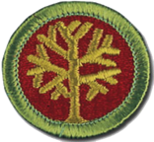


Genealogy Merit Badge
Silicon Valley Chapter
Santa Clara Chapter
Nancy Hughes, Regent of the DAR Santa Clara Chapter
Sue Fitzpatrick, DAR, Santa Clara Chapter and District Registrar
Bill Jennings, Compatriot of the SAR Silicon Valley Chapter
Ken Bower, Troop 582 ASM and Family Genealogist
Saturday, January 18th: 8am – 10am
Immanuel Lutheran Church of Saratoga, Room 2

Slide 2
Genealogy Merit Badge - Introductions
Nancy Hughes, Regent of DAR Santa Clara Chapter, 23 year member of the DAR, Daughters of American Colonists.
Sue Fitzpatrick, 7 year member of DAR, DAR District Registrar; New England Women; Colonial Dames XVII Century, Daughters of American Colonists, Native Daughters of the Golden West; Minnesota Territorial Pioneers, Nationals Society of Daughters of the Union 1861-1865
Ken Bower, Troop 582 ASM and family genealogist
Bill Jennings: Sons of the American Revolution, General Society of Colonial Wars, Jamestowne Society, Order of Founders and Patriots, Saints and Sinners

Slide 3
Genealogy Merit Badge – Class Agenda
Introductions on Instructors / Counselors, and what their lineage society does: and how it touches Scouting
Some presentation on definitions and requirements
Working Groups to create your own timeline and short-biography
Review and help with family group sheets and three generations of yourself and ancestors
Discussion on what each of you have learned
Sign-off Bluecards for completed requirements

Slide 4
Genealogy Merit Badge – Pre-Work
Preparation before class today; or work needed after class to complete the merit badge:
Report on a discussion with a family member (3)
One Document that would be used to support information in the first three generations (4b, 4c)
Your birth certificate would meet this requirement
Information on yourself, parents, and grandparents (6)
Birth, Marriage, Death (if not living): locations and dates
Family Group Sheet filled out (7)
If not completed today, when the above items are completed, you can show Mr. Jennings at a future Troop meeting and he will sign off the blue card accordingly, as he is a Merit Badge Counselor for Genealogy.

Slide 5
Genealogy Merit Badge - Requirements
5. Contact ONE of the following individuals or institutions. Ask what genealogical services, records, or activities this individual or institution provides, and report the results:
A genealogical or lineage society
A professional genealogist (someone who gets paid for doing genealogical research)
A surname organization, such as your family’s organization
A genealogical educational facility or institution
A genealogical record repository of any type (courthouse, genealogical library, state or national archive, state library, etc.)

Slide 6

Genealogy Merit Badge - Requirements
5. Contact ONE of the following individuals or institutions. Ask what genealogical services, records, or activities this individual or institution provides, and report the results:
http://www.lineagesocietyofamerica.com/list-of-lineage-societies.html
A genealogical or lineage society
Silicon Valley Chapter, California Society
Sons of the American Revolution
Santa Clara Chapter
Daughters of the American Revolution

Slide 7
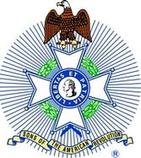
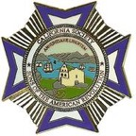
Silicon Valley Chapter
California Society
Sons of the American Revolution
Our Purpose
The National Society of the Sons of the American Revolution was organized on April 30, 1889, to “perpetuate the memory of those who, by their services or sacrifices during the war of the American Revolution, achieved the independence of the American People.”
What We Do
We decorate the graves of Revolutionary War soldiers and patriots. We support excellence in teaching of American history. We participate in patriotic observances. We support research and preservation of historic material relating to the men and women who fought or gave service for Independence in the American Revolutionary War.

Slide 8

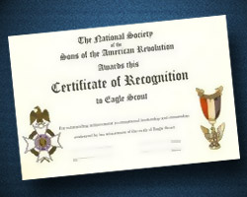
Sons of American Revolution and Scouts
Arthur M and Berdana King Eagle Scout Program
For Eagle Scouts that are not yet 19, can apply each year
Application, 4 generation form, 500 word essay
Up to $10,000 in a Scholarship at National Level
Mr. Jennings has asked if females can enter this contest
Robert E. Burt Award
Honor for members of SAR who act as role models and provide dedicated service to the young men in Scouts
Eagle Scout Certificate of Recognition
SAR will provide if requested

Slide 9
Santa Clara Chapter
Daughters of the American Revolution
Our Purpose
The National Society Daughters of the American Revolution (NSDAR or DAR) was founded in 1890 to promote historic preservation, education, and patriotism. It’s members are descended from the patriots who won the American independence during the Revolutionary War. DAR is one of the world’s largest and most active service organizations.
What We Do
DAR members are committed to volunteer service having served more than 12.5 million hours in communities throughout the world during the past three years. They support active-duty military personnel and veteran patients, awarding thousands in scholarship, and supporting underserved children with donations.

Slide 10
Genealogical Services or Records provided
Daughters of American Revolution
GRS: Genealogical Research System: a free resource to aid in general genealogical research. It is a collection of databases amassed by the DAR since its founding in 1890. Very nice Record Copies of Applicants with proof materials available on many applications – can download for a fee.
DAR Library: Washington, DC.
DAR Genealogical Research Services: Hourly rate
Sons of American Revolution
SAR Genealogical Research Library: Louisville, KY
SAR Genealogical Research Service: Hourly rate

Slide 11
Genealogy Merit Badge - Requirements
Explain to your counselor what the words
genealogy,
ancestor, and
descendant
mean.

Slide 12
Genealogy Merit Badge - Requirements
Explain to your counselor what the words:
Genealogy (from Greek: γενεά genea, "generation"; and λόγος logos, "knowledge"), also known as family history, is the study of families and the tracing of their lineages and history. Genealogists use oral interviews, historical records, genetic analysis, and other records to obtain information about a family and to demonstrate kinship and pedigrees of its members. The results are often displayed in charts or written as narratives.
From Wikipedia, the free encyclopedia

Slide 13
Genealogy Merit Badge - Requirements
Explain to your counselor what the words:
“An ancestor or forebear is a parent or (recursively) the parent of an ancestor (i.e., a grandparent, great-grandparent, great-great-grandparent, and so forth). Ancestor is "any person from whom one is descended. In law the person from whom an estate has been inherited."[1] Two individuals have a genetic relationship if one is the ancestor of the other, or if they share a common ancestor from the past. In evolutionary theory, species which share an evolutionary ancestor are said to be of common descent.”
From Wikipedia, the free encyclopedia

Slide 14
Genealogy Merit Badge - Requirements
Explain to your counselor what the words:
“A lineal descendant, in legal usage, is a blood relative in the direct line of descent - the children, grandchildren, great-grandchildren, etc. of a person. In a legal procedure sense, lineal descent refers to the acquisition of estate by inheritance from grandparent to parent and parent to child, whereas collateral descent refers to the acquisition of estate or real property by inheritance from sibling to sibling, and cousin to cousin.
Adopted children, for whom adoption statutes create the same rights of heirship as children of the body, come within the meaning of the term "lineal descendants," as used in a statute providing for the non-lapse of a devise where the devisee predeceases the testator but leaves lineal descendants.”
From Wikipedia, the free encyclopedia

Slide 15
Genealogy Merit Badge - Requirements
2. Do ONE of the following:
a. Create a time line for yourself or for a relative. Then write a short biography based on that time line.
b. Keep a journal for six weeks. You must write in it at least once a week.

Slide 16
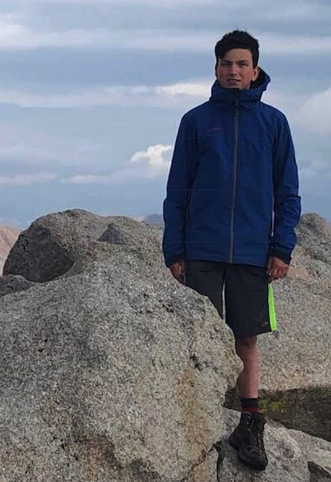
William Charles Jennings Timeline
Born: 19 Apr 2004, Mtn View
Baptism: 28 Nov 2004, Los Altos
Brother born: 10 Jul 2006, Mtn View
Brother born: 20 Jun 2011, Mtn View
First Communion: 6 May 2012, Los Altos
Joseph’s Dreamcoat: 22 Feb 2014, San Jose
Arrow of Light: 6 Jun 2015, San Jose
Sister born: 10 Apr 2014, Los Gatos
Mom died: 16 Sep 2014, San Jose
Life Scout: 6 Nov 2017, Saratoga
Climbed Mt. Shavano: Jun 2018, Colorado
Starts at Bellarmine: Sep 2018, San Jose
Confirmation: 23 May 2019, San Jose

Slide 17
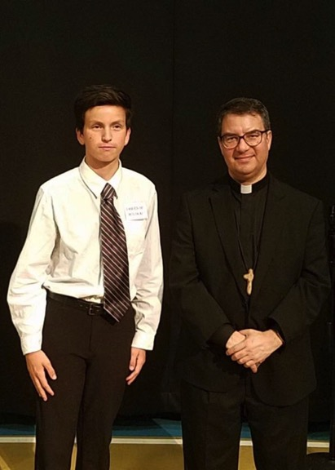
William Charles Jennings Short Bio
William Charles Jennings was born April 19th, 2004 in El Camino Hospital in Mountain View, California. He was the first son, and second child, of William Eugene Jennings and Patricia Bock Jennings. Will was baptized at St. Nicolas Catholic Church in Los Altos on November 28th, 2004 with his Godparents Lory and Eric Nagel. He had two brothers and a sister born in 2006, 2011, and 2014. Will received his first communion at St. Simon Catholic Church on May 6th, 2012. He was Zebulon in the play Joseph’s Dreamcoat in February 2014. Will crossed over from Webelos to Scouts on June 6th, 2015. Sadly, his Mom died in September 2014. Will earned his Life Scout Rank in Troop 581 on November 6th, 2017. His high-adventure trip to Colorado, culminating in climbing a 14er, Mt. Shavano, was in June 2018. Will started High School at Bellarmine College Prep “Go Bells” in September 2018. Will was confirmed at Our Lady of Peace by Bishop Cantu in May 2019.

Slide 18
Genealogy Merit Badge - Requirements
Now let’s take 10 minutes and have you list some key events (timeline) in your life.
Some key events may include: Birth, any family moves, starting school, key things you are proud of (won a sports or robotics tournament), religious milestones (baptism, etc.), birth of siblings. There is no “right answer”.
Instructors will walk around and help.
Afterwards will take another 15 minutes to create a short biography of your life based on the key events above. This needs to be written or typed (not oral).
Raise your hands and ask for help if you need it.

Slide 19
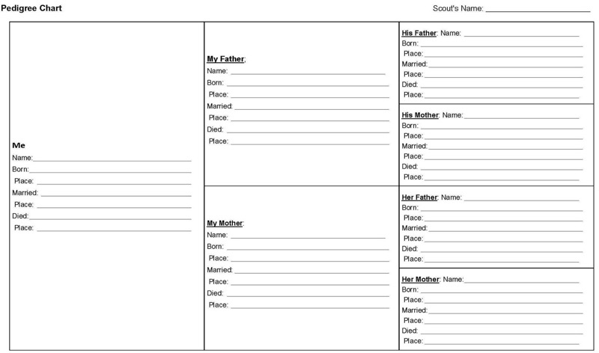
Genealogy Merit Badge - Requirements
6. Begin your family tree by listing yourself and include at least two additional generations. You may complete this requirement by using the chart provided in this pamphlet or the genealogy software program of your choice.

Slide 20
Genealogy Merit Badge - Requirements
4.
a. Name three types of genealogical resources and explain how these resources can help you chart your family tree.
b. Obtain at least one genealogical document that supports an event that is or can be recorded on your pedigree chart or family group record. The document could be found at home or at a government office, religious organization, archive, or library.
c. Tell how you would evaluate the genealogical information you found for requirement 4b.

Slide 21
Genealogy Merit Badge - Requirements
4.
Name three types of genealogical resources and explain how these resources can help you chart your family tree.
Vital Records
Census Records
Newspapers
Family and Local Histories
Family Documents
Lineage Societies

Slide 22
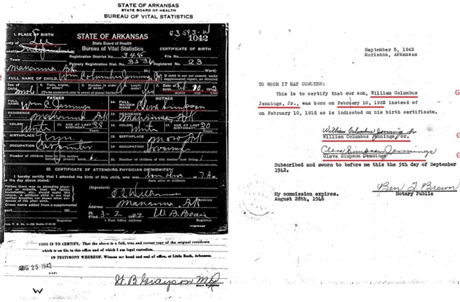
Genealogy Merit Badge - Requirements
4.
b. Obtain at least one genealogical document that supports an event that is or can be recorded on your pedigree chart or family group record. The document could be found at home or at a government office, religious organization, archive, or library.

Slide 23
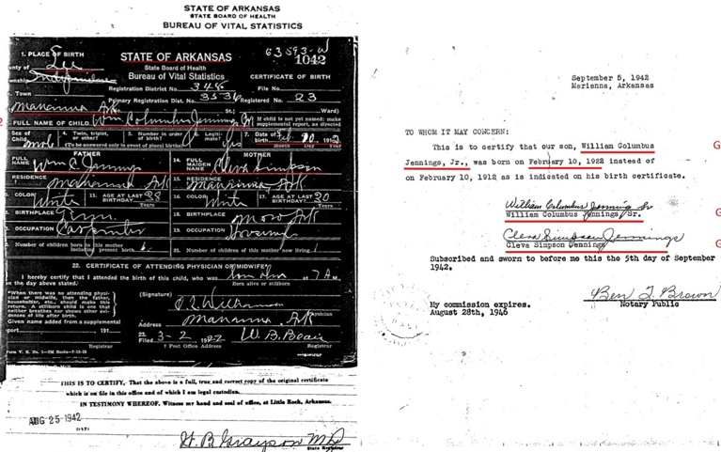
Genealogy Merit Badge - Requirements
4.
c. Tell how you would evaluate the genealogical information you found for requirement 4b.

Slide 24
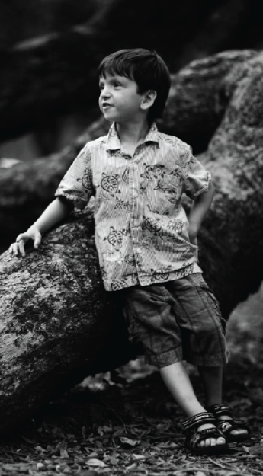
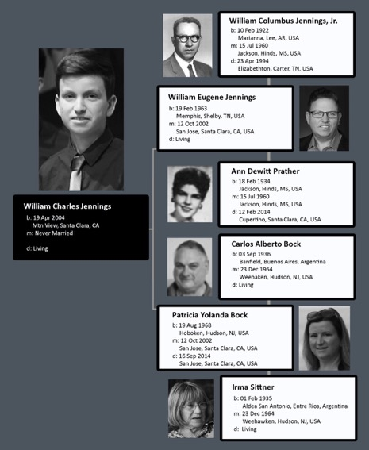

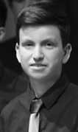
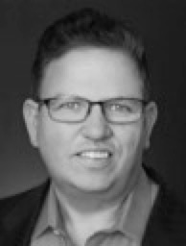
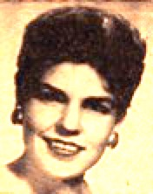

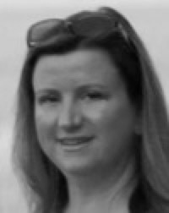

Genealogy Merit Badge - Requirements
6. Begin your family tree by listing yourself and include at least two additional generations.

Slide 25
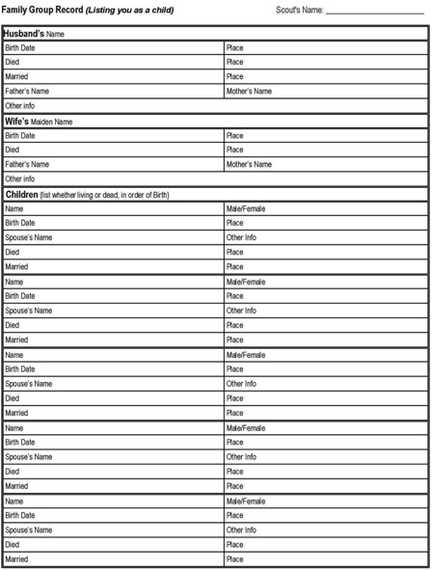
Genealogy Merit Badge - Requirements
7. Complete a family group record form, listing yourself and your brothers and sisters as the children. On another family group record form, show one of your parents and his or her brothers and sisters as the children. This requirement may be completed using the chart provided or the genealogy software program of your choice.

Slide 26
Family Group Sheets: William Charles Jennings
William Charles Jennings
(one of your parents)
William Charles Jennings
William Eugene Jennings
William Columbus Jennings, Jr.
19 Feb 1963 Memphis, Shelby, TN, USA
Living
12 Oct 2002 San Jose, Santa Clara, CA, USA
10 Feb 1922 Marianna, Lee, AR, USA
23 Apr 1994 Elizabethton, Carter, TN, USA
15 Jul 1960 Jackson, Hinds, MS, USA
William Columbus Jennings, Jr. Ann Dewitt Prather
William Columbus Jennings Cleva Simpson
Patricia Yolanda Bock
Ann Dewitt Prather
19 Aug 1968 Hoboken, Hudson, NJ, USA
16 Sep 2014 San Jose, Santa Clara, CA, USA
18 Feb 1934 Jackson, Hinds, MS, USA
12 Feb 2014 Cupertino, Santa Clara, CA, USA
Carlos Alberto Bock
Irma Sittner
Robert James Prather Emmette Jeanne Conerly
Olivia Nicole Jennings
Female
William Eugene Jennings Male
30 Apr 2003
Mountain View, Santa Clara, CA
19 Feb 1963 Memphis, Shelby, TN, USA
Patricia Yolanda Bock
12 Oct 2002 San Jose, Santa Clara, CA, USA
William Charles Jennings Male
Robert Dewitt Jennings Male
10 Apr 1964 Memphis, Shelby, TN, USA
19 Apr 2004 Mountain View, Santa Clara, CA
Lorraine Marie Vasile
26 Sep 1994
Probably SC, USA
Henry Prather Jennings Male
10 Jul 2006 Mountain View, Santa Clara, CA
Mark Daniel Jennings Male
20 Jun 2011 Mountain View, Santa Clara, CA
Elizabeth Ann Jennings Female
10 Apr 2014 Los Gatos, Santa Clara, CA

Slide 27
Genealogy Merit Badge - Requirements
8. Do the following:
Explain the effect computers and the Internet are having on the world of genealogy.
Explain how photography (including microfilming) has influenced genealogy.

Slide 28

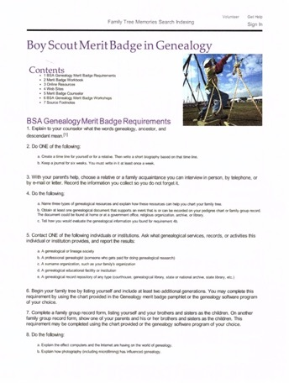
Boy Scout Merit Badge in Genealogy
Connect Generations
With a Family Search account, a world of family history possibilities comes to life. Start making connections today.
Free Account
Family Tree
Preserve and share your unique family story
Free Records
Discover information about your ancestors
Photos
Bring your family history to life with photos and stories
Collaboration
Go further faster by working together
https://familysearch.org/learn/wiki/en/Boy_Scout_Merit_Badge_in_Genealogy

Slide 29
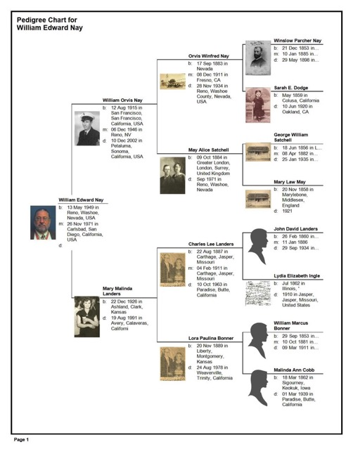
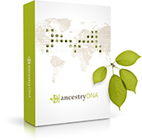
Ancestry.com
AncestryDNA kit
http://home.ancestry.com/

Slide 30
Genealogy Merit Badge - Requirements
3. With your parent’s help, choose a relative or a family acquaintance you can interview in person, by telephone, or by email or letter. Record the information you collect so you do not forget it.
This may have been done prior to the class today; if you have that with you, please review it with one of the class instructors so we can sign it off today.
If not, when it’s completed, you can show Mr. Jennings at a future Troop meeting and he will sign it off.

Slide 31
Charles Bock was born Carlos Alberto Bock in Banfield, Pvc Bs As, Argentina. He met his wife, Irma Sittner, while he lived in Argentina in his young twenties. He moved to New Jersey in 1964, and Irma moved there soon after: and they got married in December 1964. Charles worked for the large industrial engineering firm Kellogg: and he specialized in chemical plant design: mostly for crude oil processing. He worked in New Jersey for about fifteen years, and moved to Northern California in the earlier eighties: living in Green Valley near Fairfield, California.
When he moved to California, he and his partner Bob Allan started a steel fabrication company named “Cofab Steel Corporation” in January 1981. Cofab was responsible for major construction projects across Northern California, including the Chanel Building, the Bay Bridge, the San Francisco Ferry Building, and Dams near Sacramento. While at Cofab, he also started a company “Arcmatic” with a partner Bill Bong. He is an inventor on six US patents on a large scale automated welding machine (including US PTOs: 9,731,813; 7,429,716; 6,297,472; and 5,600,305).
One weekend Charles and I took a wood-fired oven cooking class together: two nights and three days – the theme was game meat. Charles used to go hunting in Patagonia with his brother Jorge, and I the weekend cooking together was fun. I knew he knew how to be a master Asador: as I have watched him cook meat flawlessly over a wood fire for birthdays, family gatherings, and holidays. What I hoped from the weekend was to hear his hunting stories: his exploits in Patagonia. He would drive out into the wilderness in an old station wagon, with his brother, his weapons, and the tools needed to repair the car if it broke down. He would be in regions without roads, and without bridges, and many hundreds of miles from the nearest town. Charles and Jorge would be hunting wild boar: and one time, after scouting out a watering hole a few days: he setup to get the boar that came each day. They usually approached from one side of the spring fed pool, so he setup on the other side of that: to get a good shot at the boar. Then the day they were ready, the boar came: but came from another direction: coming up right behind them. Charles shot the boar twice, and it didn’t stop – his brother Jorge made the lethal shot for the boar, while it was charging towards his brother Charles: and the boar stopped within feet of Charles! Charles was an amazing marksman, and he also had the ability to do heavy exercise, stop, and make a clean shot. He was recruited by Argentina to be on the Olympic Bi-athlete team: cross-country skiing and shooting combined. He didn’t join the team, but from that you must know he was a marksman!
Another time, Charles tells the story of sitting up in the cab of a steam locomotive as a young adult. He rode the engine into Buenos Aires from the coast where he spent his summers. The locomotive was due to return to the south, and the main guy on the railroad asked him if he wanted to drive it home: as he was impressed by how much Charles listened and how likely he would do a good job. So, Charles (with supervision) drove a locomotive for hundreds of miles after only a few hours of instruction.
Relative Story Example

Slide 32
Genealogy Merit Badge - Requirements
9. Discuss what you have learned about your family and your family members through your genealogical research.
Group Discussion: everyone must participate to complete the requirement.

