Slide 1
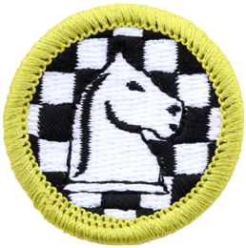
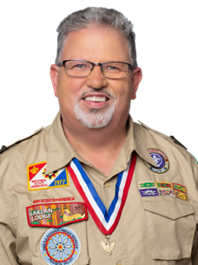
Chess
Merit Badge
Mr. Bill Jennings
ASM Troop 582
Committee Troop 581

Slide 2
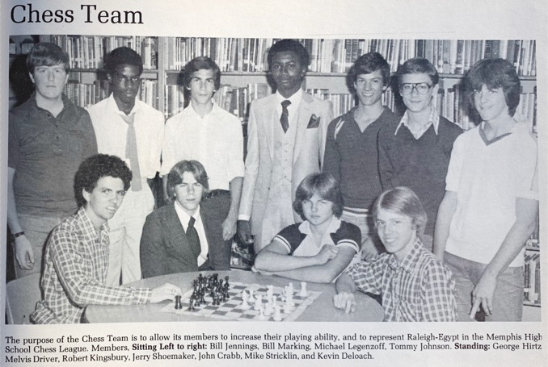
Chess Merit Badge – Counselor Intro
  Mr. Bill Jennings : ASM 582
  Chess Merit Badge was first available in 2011, so I was unable to earn this badge in the 1970s when I was a Scout.
  However, I was on my High School’s Chess team, played in tournaments, and was rated reasonably well by the United States Chess Federation.
Mr. Bill Jennings
in 1981 on the
Raleigh Egypt
High School
Chess Team
USCF rating of
nearly 1600 at
the time. Not
anywhere near
that good any
longer.

Slide 3
Using Chess Merit Badge Requirements: version 2013
Requirements version: We will be using requirements from 2013, as none of the students began this merit badge prior to 2021.
This is the URL for the requirements we are using:
  https://filestore.scouting.org/filestore/Merit_Badge_ReqandRes/Chess.pdf

Slide 4
Merit Badge Pamphlet is a handy tool
Having a merit badge pamphlet is not required.
A pamphlet can be (optionally) purchased at the Scout Shop.
Some versions have been posted online, probably breaking copyright rules.
If you happen to find one, it may help you study this badge after our discussions.
https://troop577wichita.weebly.com/uploads/1/1/2/2/11225514/chess_2011.pdf

Slide 5
Our plan for learning this merit badge
All the class members have me listed as your counselor already in Scoutbook.
I can’t require worksheets for the merit badge, but I do need to insure all Scouts know the material individually. I will have an interactive lecture for most of the requirements – I suggest that you take notes. I will follow-up with each of the Scouts to verify you know the material we discussed before signing off the requirements in Scoutbook.
One way to structure your notes is to use a worksheet found on this URL:
https://scoutingevent.com/attachment/badges/Chess.pdf
I will describe many of the requirements today, and also describe which requirements which will require work outside of today’s discussion.

Slide 6
Requirements that need to be done outside of today’s video conference
Part of Requirement 3: the part that refers to teaching someone else chess.
Requirements 5c, and 5d: demonstrate specific chess moves to force mate to your counselor: we can discuss individually when each Scout is ready.
Requirement 6: pick one of these: playing three games of chess, play in a tournament, or organize and play in a tournament.

Slide 7
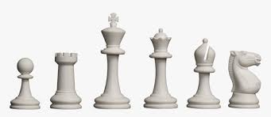
Let’s start our discussion

Slide 8
Chess Merit Badge Requirement 1
1. Do the following:
  a. Discuss with your merit badge counselor the history of the game of chess.
  b. Explain why it is considered a game of planning and strategy.

Slide 9
Chess Merit Badge Requirement 1.a.
1. a. Discuss with your merit badge counselor the history of the game of chess.
Originated in India
6th Century – called chaturanga
In Persia called chatrang, evolved to shatranj
Started calling “Shah Mat!” meaning “the king is helpless”
Spread to Europe by the year 1000
Computer beats Grandmaster in tournament in 1997
History of Chess video:
https://youtu.be/5Xua232qncg

Slide 10
Chess Merit Badge Requirement 1.b.
1. b. Explain why it is considered a game of planning and strategy
Planning:
Two equally strong armies have gathered on opposite sides of a river. One
commander evaluates the pluses and minus of his and the enemy’s army’s
dispositions and comes up with a plan taking into account possible counter-attacks. The other relies on the strength of his troops and charges forward.
The outcome of the battle is rather predictable, isn’t it?
In chess, the same thing happens all the time. A player who simply makes the moves he likes and hopes to win by random tactics usually succumbs to an opponent who has a plan behind his moves.

Slide 11
Chess Merit Badge Requirement 1.b.
1. b. Explain why it is considered a game of planning and strategy
Strategy:
Concerned with the evaluation of chess positions and setting goals for long-term plans and future play.
Position of pieces
Pawn structure
King safety
Control of key squares
Piece Development

Slide 12
Chess Merit Badge Requirement 2
2. Discuss with your merit badge counselor the following:
  a. The benefits of playing chess, including developing critical thinking skills, concentration skills, and decision-making skills, and how these skills can help you in other areas of your life
  b. Sportsmanship and chess etiquette

Slide 13
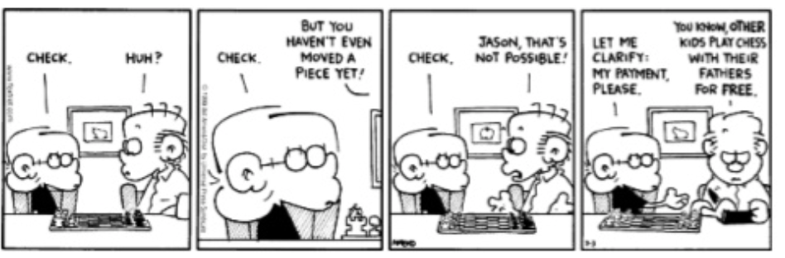
Chess Merit Badge Requirement 2.a.
2. a. The benefits of playing chess, including developing critical thinking skills, concentration skills, and decision-making skills, and how these skills can help you in other areas of your life

Slide 14
Chess Benefits
Abstract reasoning – reaching conclusions from previous knowledge
Analysis – breaking something down into smaller things to solve
Concentration – the ability to direct your attention to one thing
Creativity – ability to think of something and bring it to reality
Critical thinking – applying logic and careful reasoning

Slide 15
Chess Benefits
Evaluation – determining the value of something
Pattern Recognition – recognizing something that you have previously seen and knowing what to do in that situation
Problem Solving – recognizing a problem and coming up with a workable solution
Strategic Planning – deciding what is to be done with the resources available
Synthesis – combining previous knowledge to help out in a current situation

Slide 16
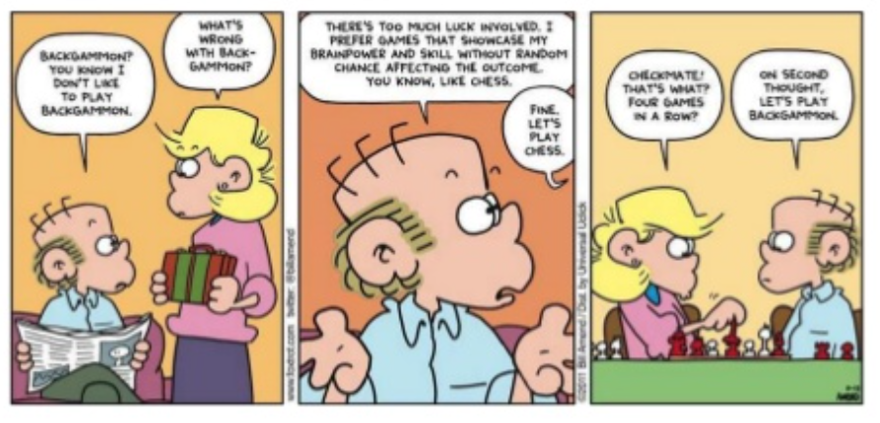
Chess Merit Badge Requirement 2.b.
2. b. Sportsmanship and chess etiquette
You can win – it is a game of skill
Age, position, profession, rank, gender, wealth, luck, etc. does not impact Chess
Hence, Sportsmanship and Etiquette are especially important

Slide 17
Chess Sportsmanship
Start and end with a handshake
Never gloat over a victory
Do not distract your opponent
Cell phones off
Observe, do not comment, on games in progress
Follow Touch-Move rule (be careful when castling)
Avoid frequent adjusting of pieces
Position the pieces generally in the center of the square, to avoid upsetting those with OCD
Behave with respect

Slide 18
Chess Merit Badge Requirement 3
Demonstrate to your counselor that you know each of the following. Then, using Scouting’s Teaching EDGE, teach someone (preferably another Scout) who does not know how to play chess:
    a. The name of each chess piece
    b. How to set up a chessboard
    c. How each chess piece moves, including castling and en passant captures

Slide 19
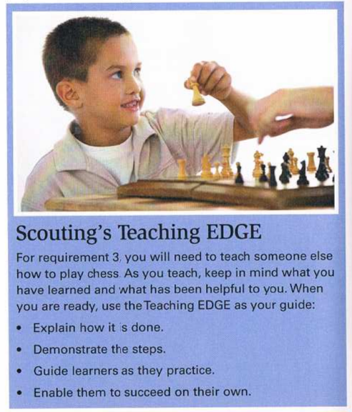
Reminder: EDGE method of teaching
  Due to Covid-19 restrictions, I will accept you teach, or review how to play chess, with another member of your family, assuming you complete your badge prior to May 2021 with me.

Slide 20
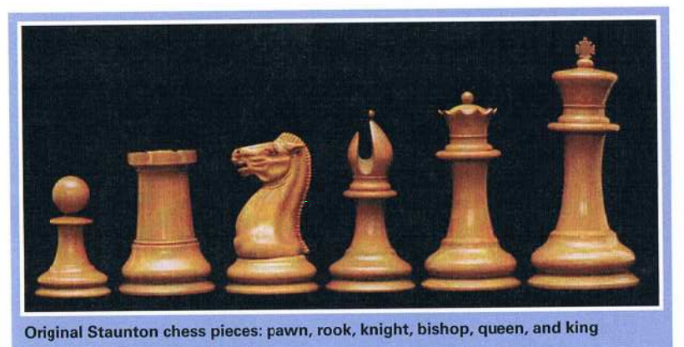
Chess Merit Badge Requirement 3.a.
  3.a. The name of each chess piece
Also, typical at a tournament: a chess board, a chess move clock, and a score sheet

Slide 21
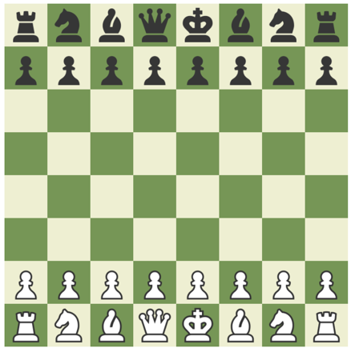
Chess Merit Badge Requirement 3.b.
  3. b. How to set up a chessboard
Set up the board oriented such that the “white” square is on the “right”.
Then place the pieces on the board:
Eight Pawns on second row
Two Rooks on outside
Then two knights next to rooks
Then two bishops next to knights
Queen is placed on her own color
(black queen on black square,
white queen on white square)
King is next to the Queen
Board is setup, ready to play.
White moves first.

Slide 22
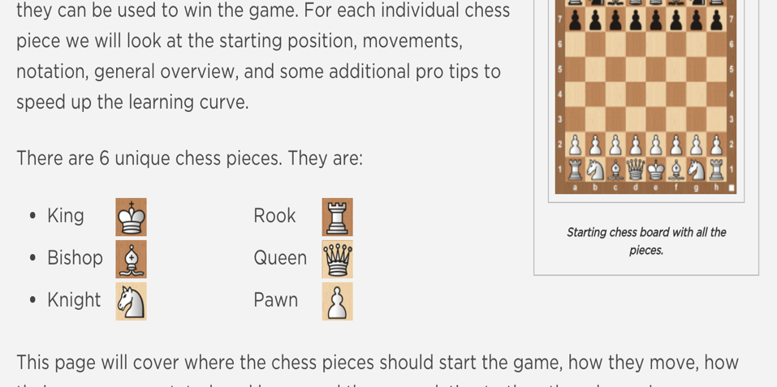
Chess Merit Badge Requirement 3.c.
  3.c. How each chess piece moves, including castling and en passant captures

Slide 23
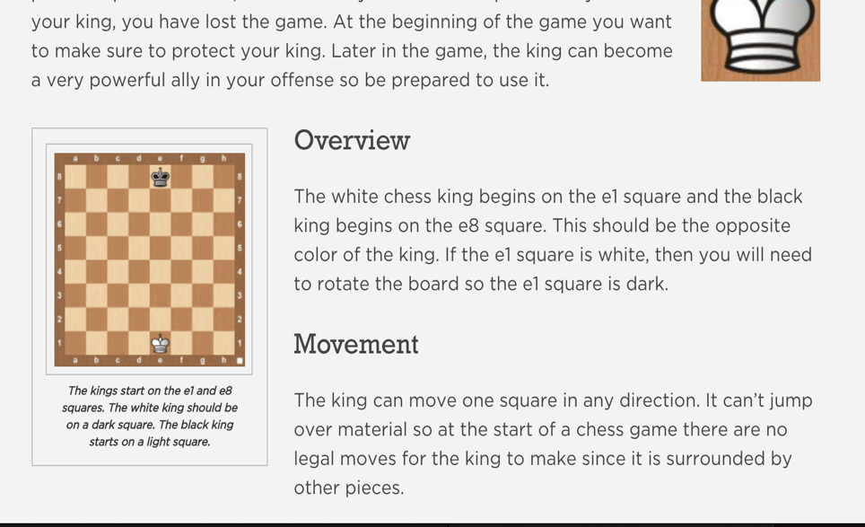
King Movement

Slide 24
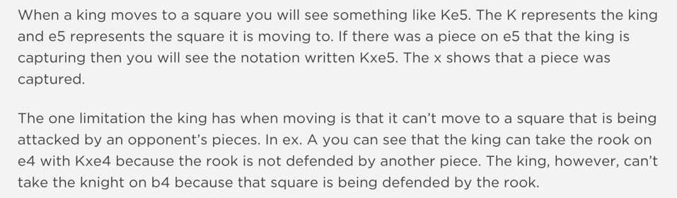
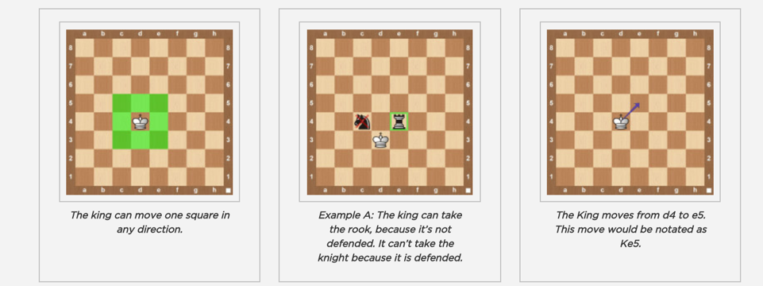
More about the King

Slide 25
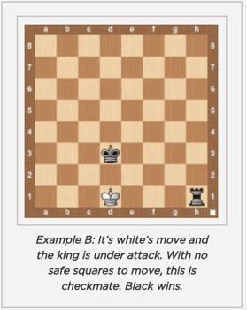
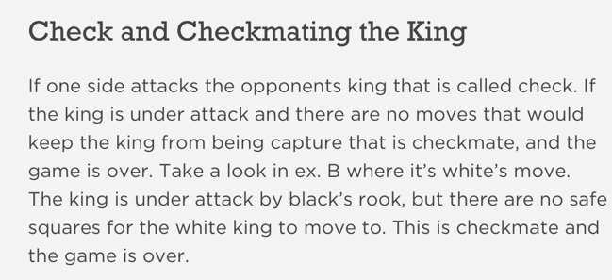
When the King is attacked and can’t move without being in attack, the game ends

Slide 26
Castling
How
  Move King 2 squares to the left or right
  Bring Rook to other side of King
Restrictions
  King may not be placed into check
  King may not pass through a controlled square
  Neither Rook, nor King may have already moved
  The squares in between must be empty
  King may not castle out of check
Youtube Video on Castling
https://youtu.be/M72DEPy9alk

Slide 27
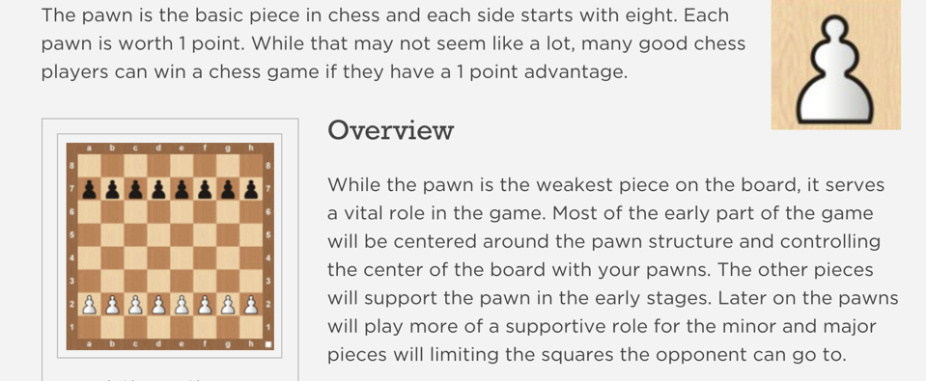
Pawn

Slide 28
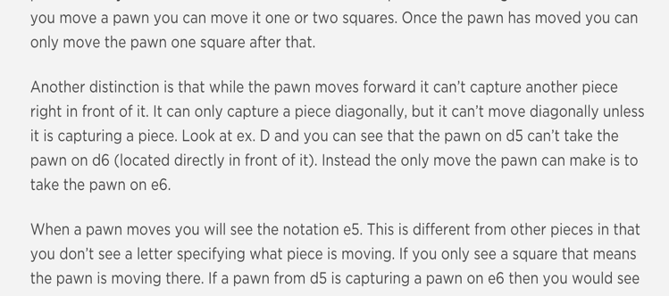
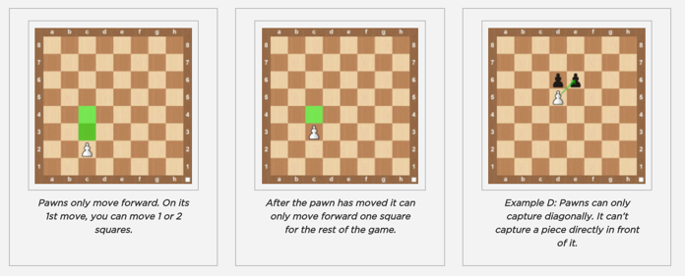
Pawn Movement

Slide 29
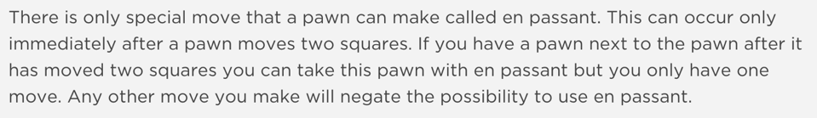
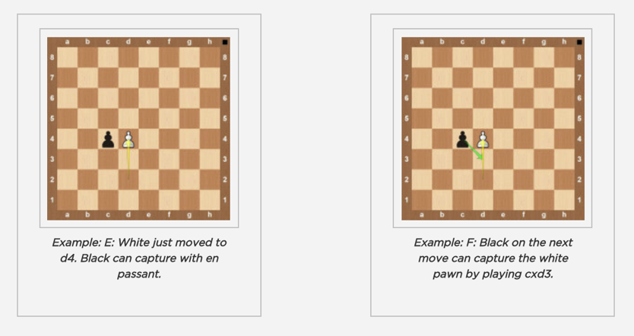
En Passant, a special Pawn move

Slide 30
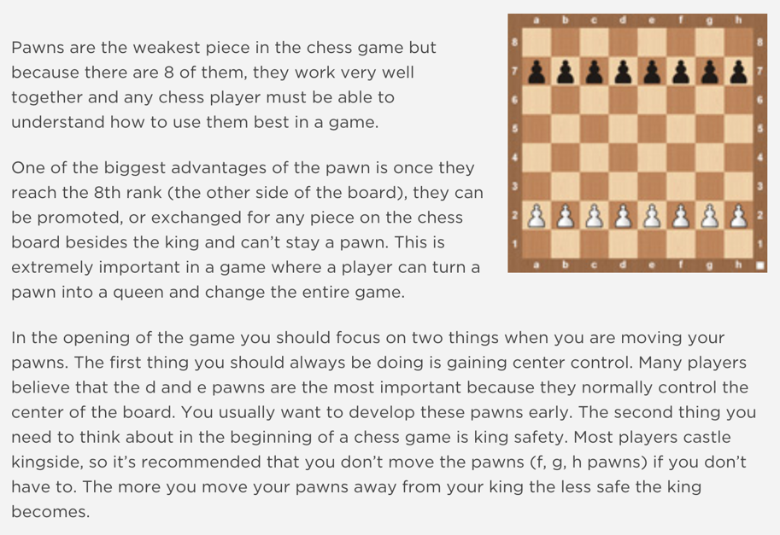
More about the Pawn

Slide 31
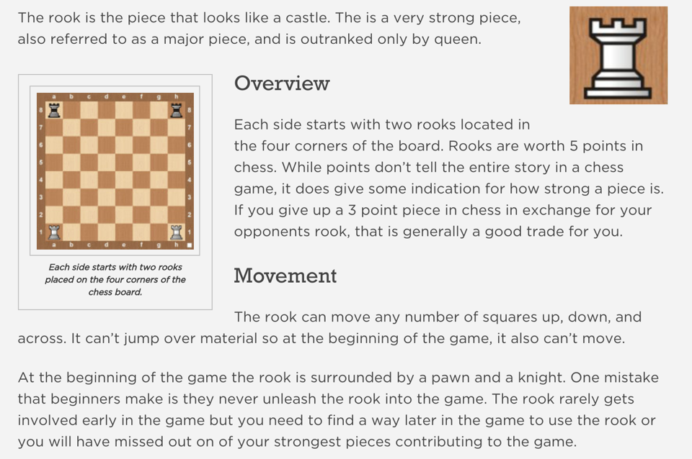
Rook

Slide 32
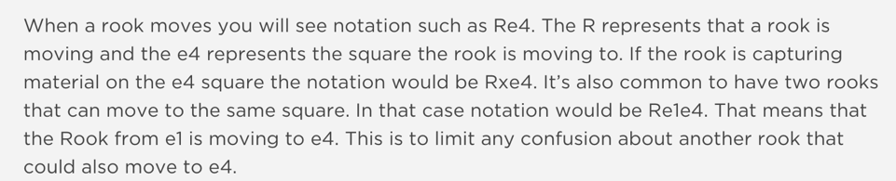
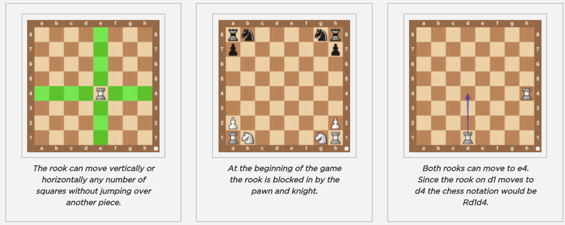
More about the Rook

Slide 33
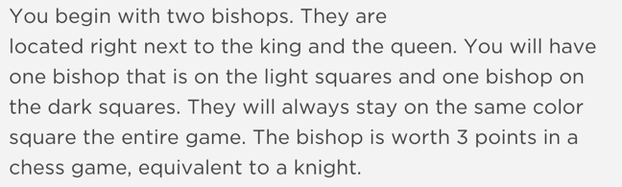
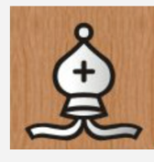

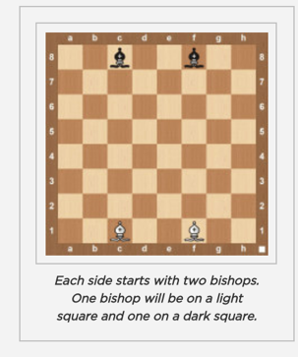
Bishop

Slide 34
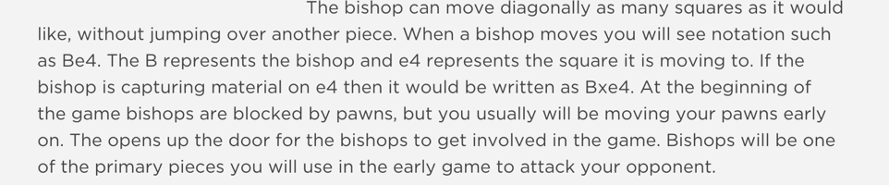
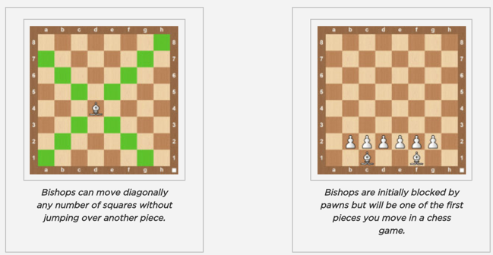
Bishop Movement

Slide 35
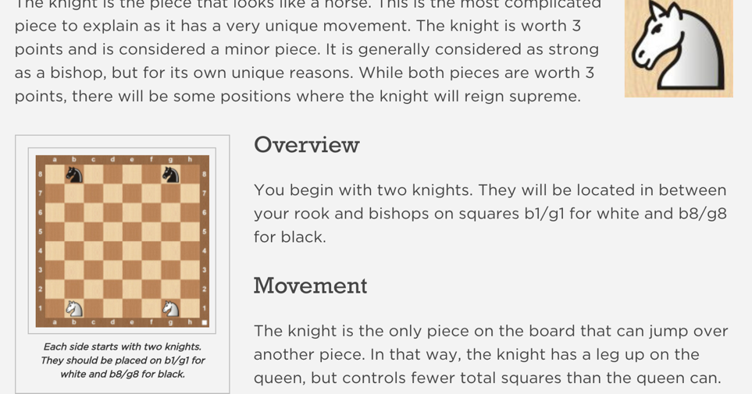
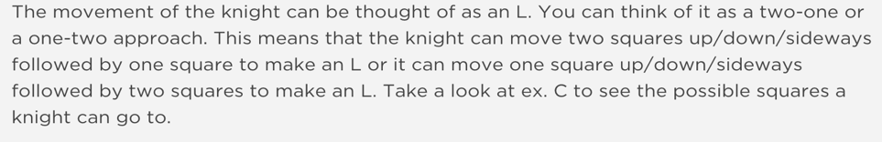
Knight

Slide 36
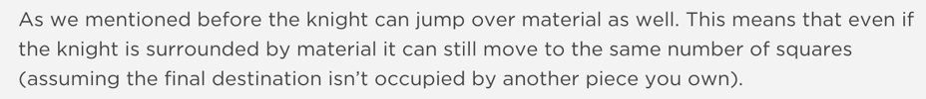
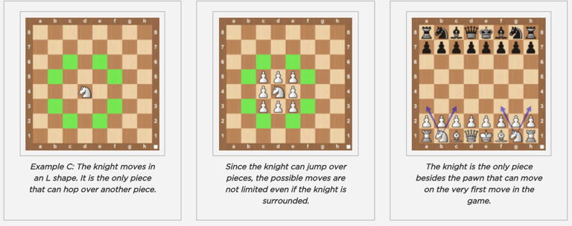
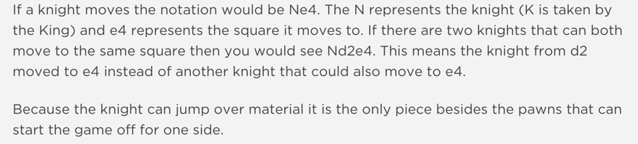
More about the Knight

Slide 37
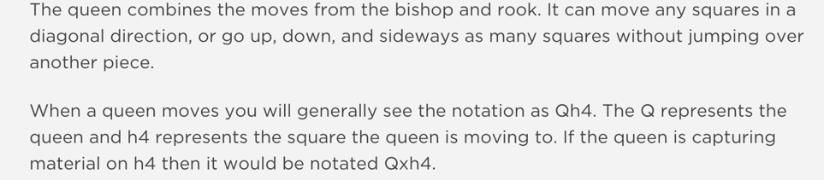
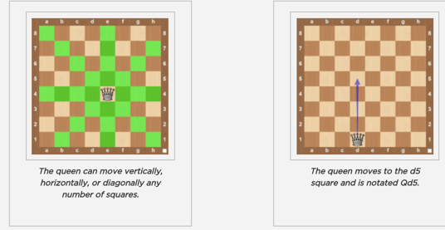
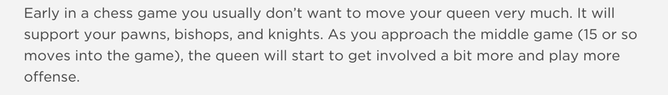
Queen Movement

Slide 38
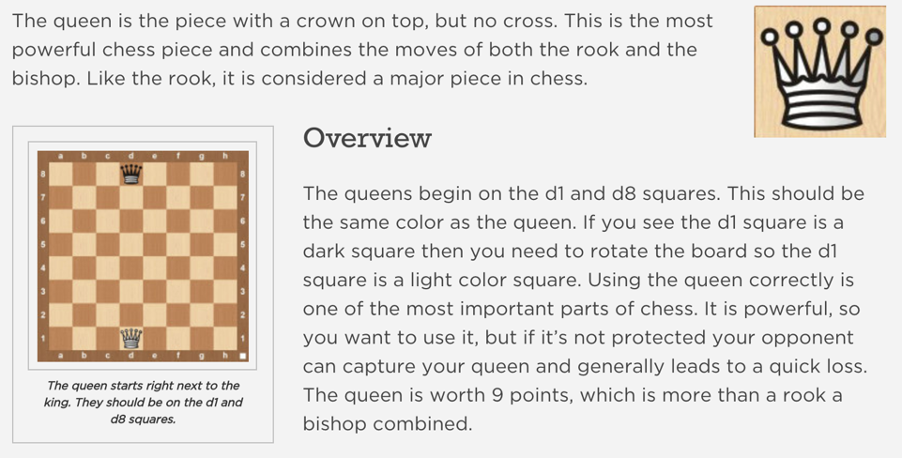
More about the Queen

Slide 39
Requirement 4
Do the following:
  Demonstrate scorekeeping using the algebraic system of chess notation.
  Discuss the differences between the opening, the middle game, and the endgame.
  Explain four opening principles.
  Explain the four rules for castling.
  On a chessboard, demonstrate a "scholar's mate" and a "fool's mate."
  Demonstrate on a chessboard four ways a chess game can end in a draw.

Slide 40
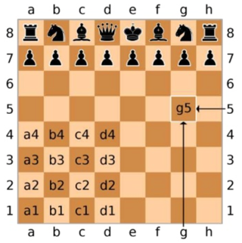
Req’t 4.a: Algebraic Notation
Indicate where you move with piece, rank, and file (row and column). If the piece is a pawn, just indicate rank and file. Use lower case letters for file, capital letters for pieces.
All non-pawn pieces have a capital letter associated to them: “K” – King, ”N” – Knight, “Q” – Queen, “R” – Rook, “B” – Bishop.
If more than one piece of the same type could have made the move, use the source rank or file first. Example: Rae1 or N8d7.
When you capture a piece, place an ”x” between the name of the piece and the destination. Example: Kxe2, or Qxh5.
When a pawn reached the final rank, indicate the square moved to and the final piece. Example: a8=Q.
When you castle, you write O-O for king side, or O-O-O for queen side.
A check is indicated by a plus at the end of the move. Example: Rh8+ or Qxe2+. Mate can be “#” or “mate”
Each line of squares going left to right across the board is called a “rank”. For example, at the start of the game, all your pawns are on the same rank. Ranks are numbered 1, 2, 3, 4, 5, 6, 7, 8. The first rank is always where White sets up his major pieces; the eighth rank is where Black sets up his major pieces. No matter what color you play, the rank in front of Black is always #8!

Slide 41
Req’ t 4.b: Opening, Middle, End game
Opening
  The first 4 to 10 moves
  Many sequences well known
  Well studied and memorized
Middle Game
  More complicated with more options
  Must rely on strategies and planning
End Game
  Final stage with few pieces left
  Work to promote pawns
  Understand how to checkmate with certain piece combinations

Slide 42
Req’t 4.c: Four Opening Principles
Development
  Getting pieces off the starting squares where they can be useful for attack and defense.
Control the center
  Controlling the 16 squares in the middle makes it more difficult for your opponent to attack you, and easier for you to attack to attack your opponent. The four center square are especially important: d4, d5, e4, and e5.
Castling
  Generally done early. King is safer from center of board.
Pawn structure
  Pawns first line of defense, can’t be moved backward, and blocks opponent from getting to critical pieces.

Slide 43
Req’t 4.d: Castling (reminder from earlier)
How
  Move King 2 squares to the left or right
  Bring Rook to other side of King
Restrictions
  King may not be placed into check
  King may not pass through a controlled square
  Neither Rook, nor King may have already moved
  The squares in between must be empty
  King may not castle out of check

Slide 44
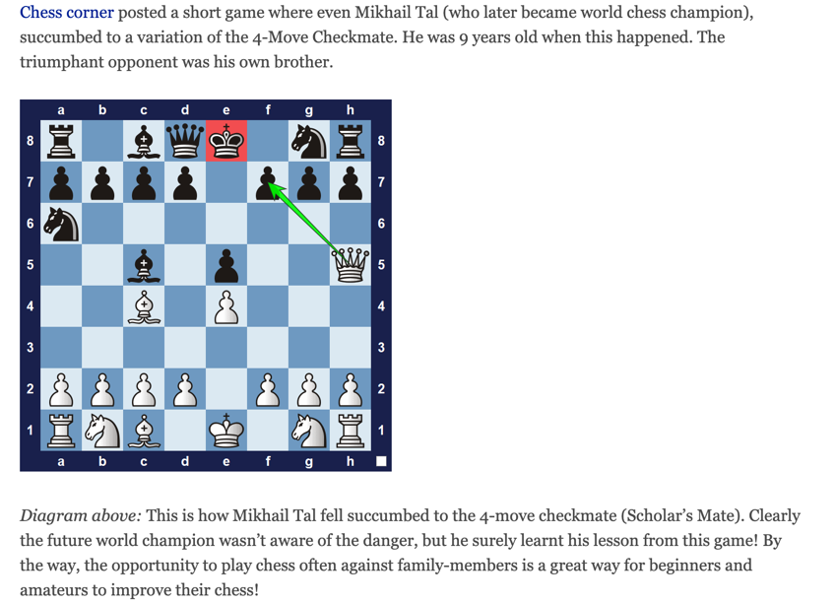
Req’t 4.e. ”Scholar’s Mate”

Slide 45
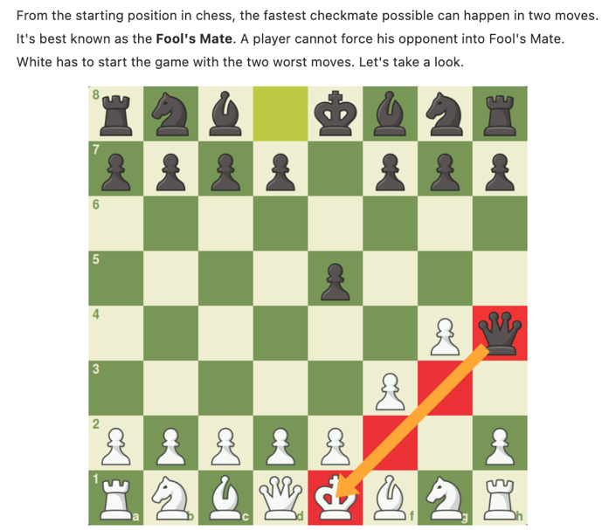
Req’t 4.d.: “Fool’s Mate”

Slide 46
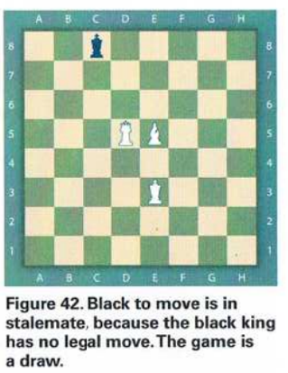
Req’t 4.f.: Ways a game ends in draw
Game has had 50 moves for each player
There is a stalemate: no legal move exists, but there is no checkmate
There is a repetition of the same position on the board three times, with same restrictions on castling, and en passant
Insufficient material: if there is no future combination of moves that could lead to a victory, it is a draw

Slide 47
Requirement 5
5. Do the following:
  a. Explain four of the following elements of chess strategy: exploiting weaknesses, force, king safety, pawn structure, space, tempo, time.
  b. Explain any five of these chess tactics: clearance sacrifice, decoy, discovered attack, double attack, fork, interposing, overloading, overprotecting, pin, remove the defender, skewer, zwischenzug.
  c. Set up a chessboard with the white king on e1, the white rooks on a1 and h1, and the black king on e5. With White to move first, demonstrate how to force checkmate on the black king.
  d. Set up and solve five direct-mate problems provided by your merit badge counselor.

Slide 48
Req’t 5.a. Explain four elements of strategy: exploiting weakness, force
Exploiting weakness
  Poor pawn structure
  Weak King
  Undeveloped pieces
  Lack of center control
Force
  Opponent has no choice: check, capture, or threat
  Fewer opponent options makes it easier to plan ahead
  Can move a king out into the open, or back into a corner
  A double-check, where 2-pieces are checking the king, forces it to move since both pieces cannot be taken

Slide 49
Req’t 5.a. Explain four elements of strategy: king safety
King Safety
  King is the most important piece
  Must keep it safe at all costs
  Doesn’t mean it cannot help: it becomes strong at the end game
  Careful moving pawn in front
  Look for stalemate
  Keep opponent’s King in mind
  Look for tactics with a weak King
  Attacks will come. Deal with it!

Slide 50
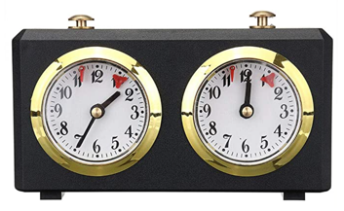
Req’t 5.a. Explain four elements of strategy: time
Time
  Time limit on game – each player gets a limited amount of time to complete all of their moves
  If one player runs out of time, the game is over, and they loose
    Blitz: 5 minutes each player
    Rapid play : 30 minutes each player
    Local League : 35 moves, 75 minutes per player
    International : 40 moves, two hours per player
  Don’t forget to check if your opponent has run out of time
  Know time limits before you play

Slide 51
Req’t 5.b. Explain Chess Tactics
5.b. Explain any five of these chess tactics: clearance sacrifice, decoy, discovered attack, double attack, fork, interposing, overloading, overprotecting, pin, remove the defender, skewer, zwischenzug.

Slide 52
Req’t 5.b. Chess Tactics: Clearance Sacrifice, Decoy, Discovered Attack
Clearance Sacrifice
A move where you give your opponent a piece in order to free up space for a move of another piece
Usually made when a checkmate is close at hand
Beware should your opponent offer you something for what appears to be free
Decoy
Ensnaring a piece, usually the King or Queen, by forcing it to move to a poor position
Discovered Attack
Moving a piece reveals an attack by another piece

Slide 53
Req’t 5.b. Chess Tactics: Double Attack, Knight Fork, Pin
Double Attack
Two attacks made at the same time
Very unlikely to defend against both attacks
Knight Fork
Use of the Knight to attack two or more pieces
When used against the King, the other attacked piece is defenseless
Pin
A piece that cannot move because it will expose a check on the King, or allow a powerful piece to be taken such as the Queen

Slide 54
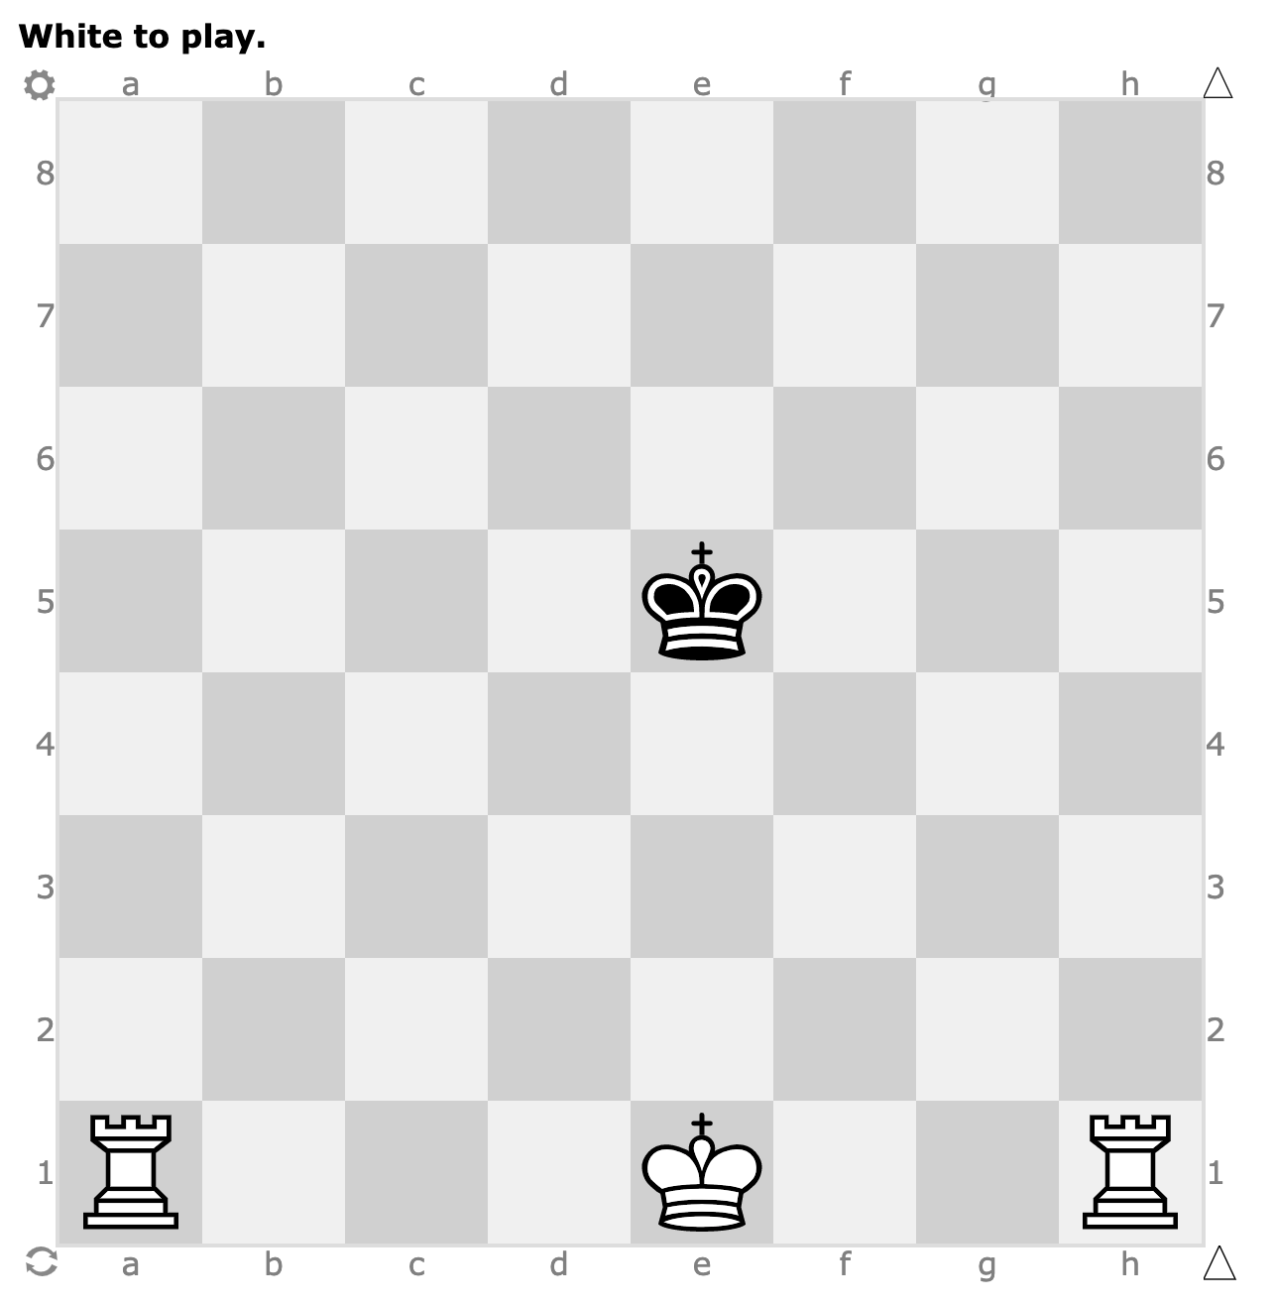
Req’t 5.c. Specific Checkmate approach
c. Set up a chessboard with the white king on e1, the white rooks on a1 and h1, and the black king on e5. With White to move first, demonstrate how to force checkmate on the black king.

Slide 55
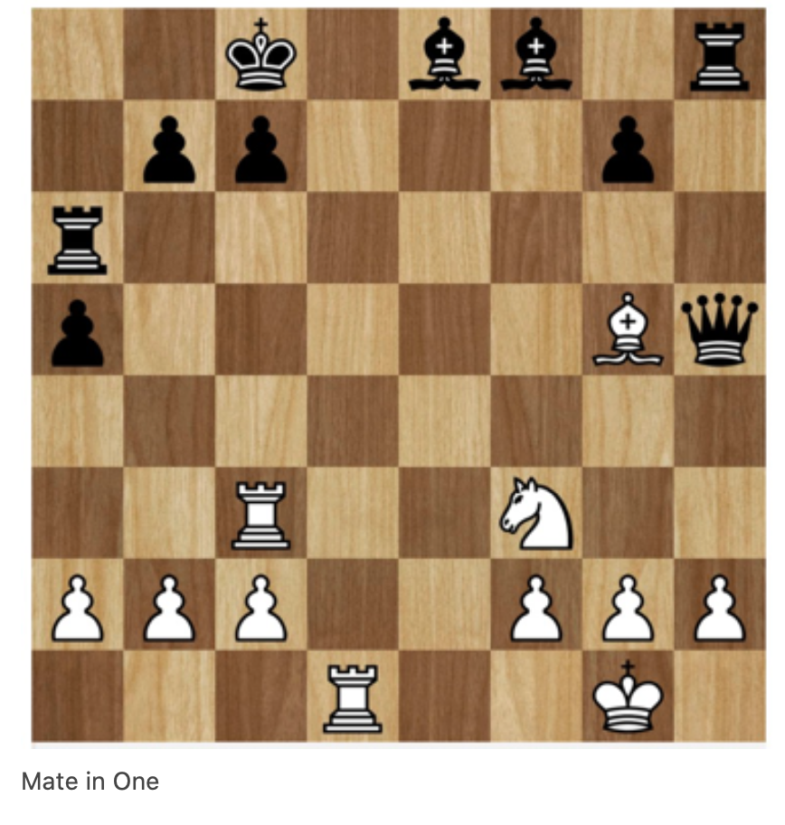
Req’t 5.d. Solve 5 mate problems
Problem 1
White to Mate in 1, and
it’s White’s move next.

Slide 56
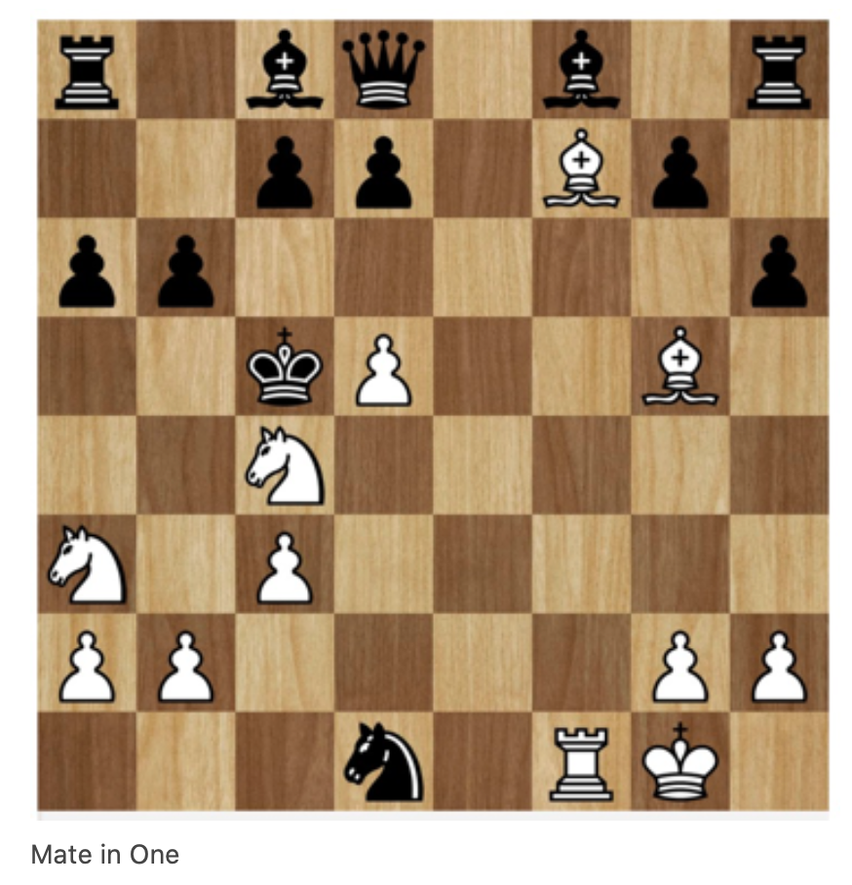
Req’t 5.d. Solve 5 mate problems
Problem 2
White to Mate in 1, and
it’s White’s move next.

Slide 57
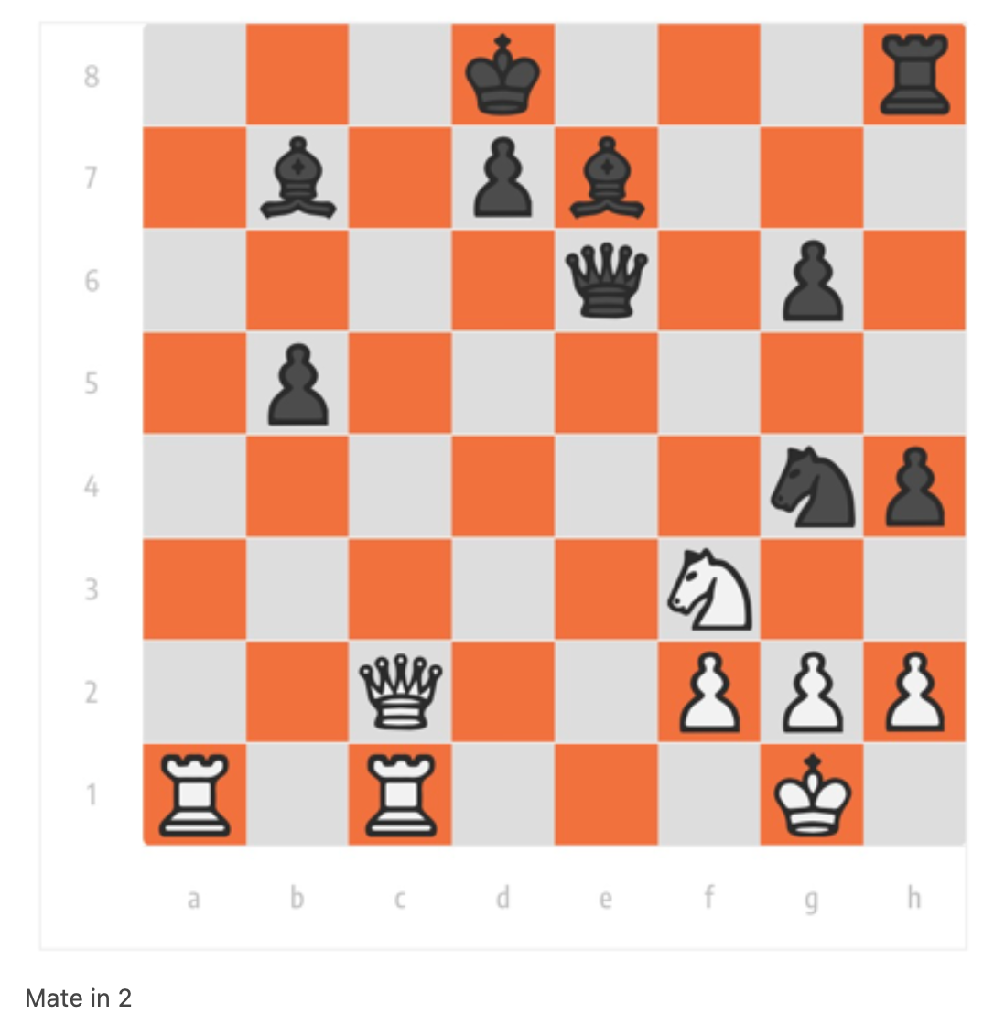
Req’t 5.d. Solve 5 mate problems
Problem 3
White to Mate in 2, and
it’s White’s move next.
Caution for potential
of stalemate.
Anticipate all possible
black moves in your
answer.

Slide 58
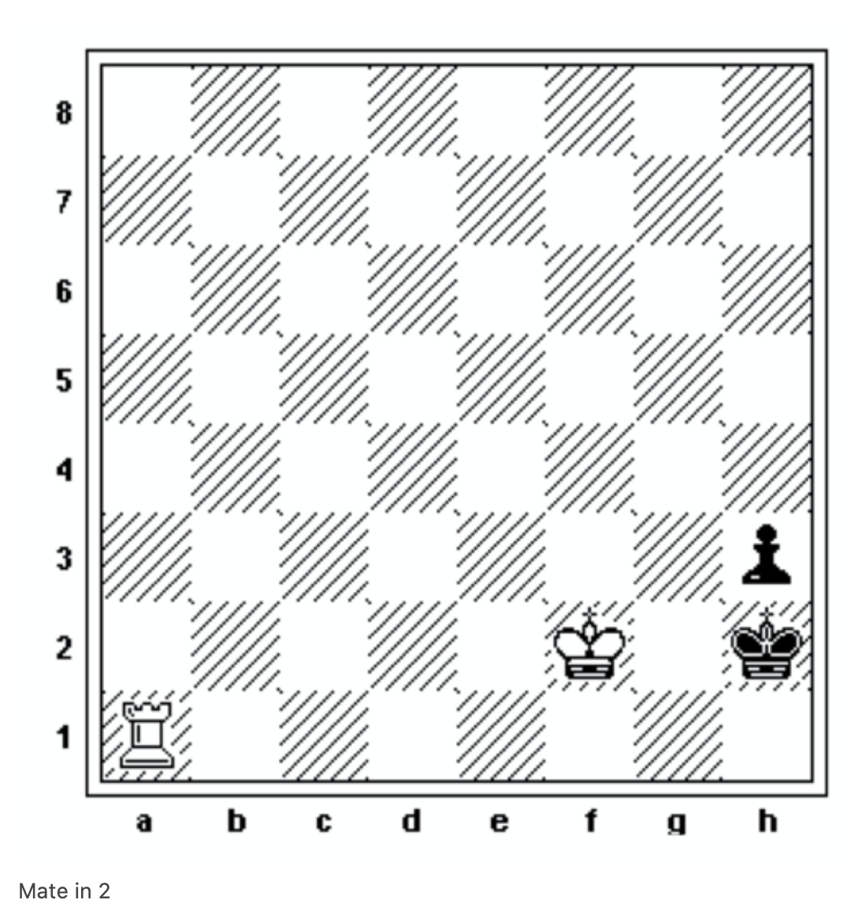
Req’t 5.d. Solve 5 mate problems
Problem 4
White to Mate in 2, and
it’s White’s move next.
Caution for potential
of stalemate.
Anticipate all possible
black moves in your
answer.

Slide 59
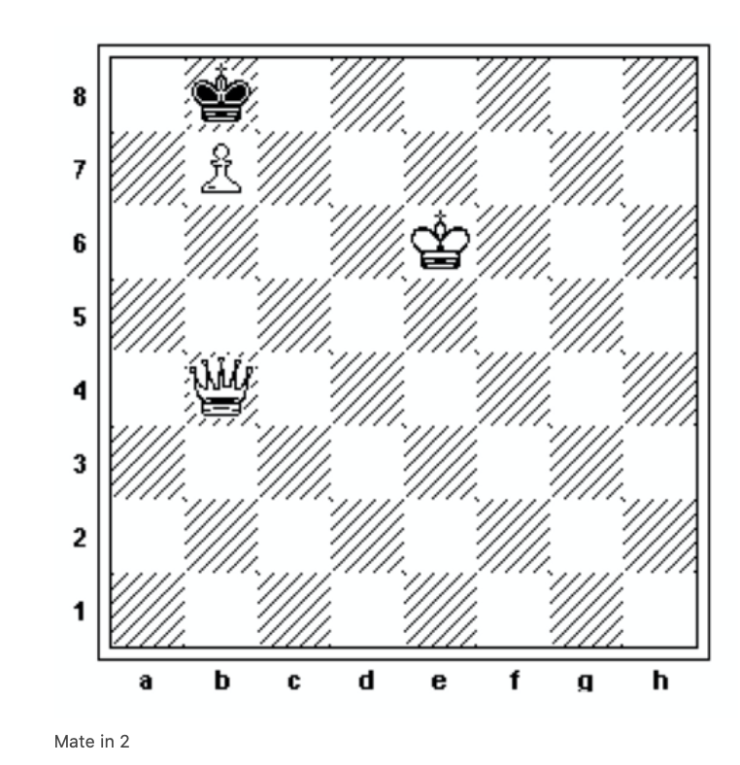
Req’t 5.d. Solve 5 mate problems
Problem 5
White to Mate in 2, and
it’s White’s move next.
Caution for potential
of stalemate.
Anticipate all possible
black moves in your
answer.

Slide 60
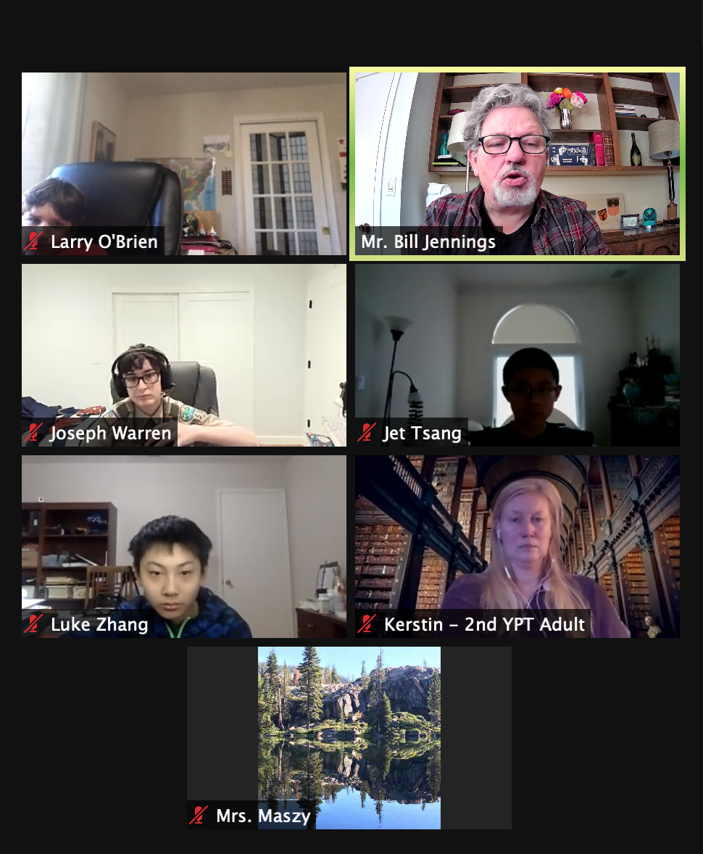
Attendees on
Chess Merit Badge
Class on Jan 17, 2021

